Slide 2
The Facts About Preconception Wellness
Preconception health refers to the health of women and men during their reproductive years. The goal is to take steps now to protect the health of a baby one might have in the future.
Identifying risk factors and intervening BEFORE pregnancy occurs can….
Decrease maternal and infant mortality
Decrease preterm births, low birth weights & other concerns
Reduce the risk of birth defects

Slide 3
What is ?
9-week health and wellness program in partnership with the YMCA and McMillen Health
Focus is on wellness before and/or in between pregnancies
Targets low-income women as well as women who may have or may be at risk for high blood pressure, diabetes, obesity, etc.
Focuses on overall health and well-being to include topics such as:
Physical Fitness
Healthy Eating & Meal Planning
Mental Health
Life Planning
And more!

Slide 4
Key Pieces of OYJ: Goals, Incentives and Journaling
Goals--
Obtain health insurance
Establish a PCP
Complete annual wellness exam
Monthly contact post completion of the 9-week program for 1 year
Incentives–
YMCA Membership
Gas Cards
OYJ Swag

Slide 5
Success of
Measured by pre & post surveys
August/September 2020 Graduation--
13 women graduated
Health insurance- 13 of 13
PCP- 12 of 13
Wellness exam- 10 of 13
Statistics from Pre & Post Surveys--
Familiarity with birth control methods improved by 72%.
Reported use of condoms increased by 11%.
Reported regular weekly exercise increased by 21%.
Recognition of unintended pregnancy’s affect on society increased by 12%.
The number of participants reporting they have made life goals increased by 11%.
The number of participants reporting they have thought about their reproductive life plan increased by 22%.
3 new groups started in October!

Slide 6
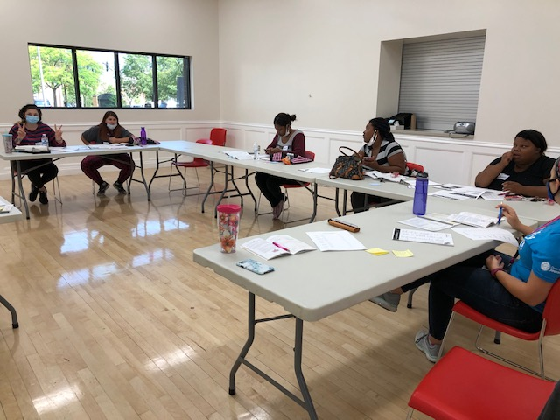
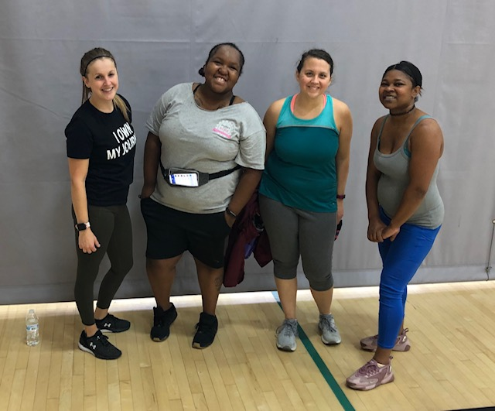
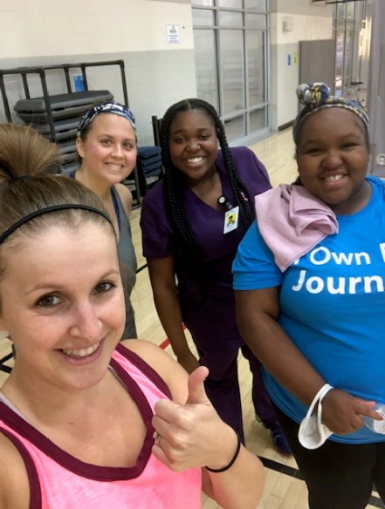

Slide 7
Referral Info:
Refer via our website:
www.healthiermomsandbabies.org/request-services
*** A paper referral form can be given to submit via fax or email upon request.
Chelsea Harris
Health and Wellness Coordinator
charris@hmbindiana.org
(260)704-0355
Notes:
30% of women served considered high risk, 42% considered moderate risk, 27% with low risk factors; average of 3 risk factors per client

