Slide 1
Domestic Violence in Immigrant and Refugee Communities

Slide 2
What is domestic violence?
A pattern of abusive behavior in any relationship that is used by one partner to gain or maintain control over another intimate partner
Physical Abuse (hitting, punching, cutting, etc.)
Sexual Abuse (sexual contact without consent)
Emotional Abuse (deflating self-esteem or self-worth)
Economic Abuse (Controlling finances)
Psychological Abuse (intimidation, threatening)
Threats (immigration)
Stalking (watching, harassing, making phone calls)
Cyberstalking

Slide 3
Power and Control
Domestic violence is about power and control
Complex and beyond physical abuse

Slide 4
Causes/Excuses
Financial Pressures (gambling)
Drug & Alcohol abuse
Generational Abuse
Typical and acceptance of “male” behavior
Culturally accepted behaviors
Cultural differences (within marriage)
Provocation from women experiencing the freedom of women’s rights
Pressure of immigrating or resettling in the United States

Slide 5
Specific Concerns for Immigrants and Refugees
Language barriers
New laws or systems
Navigating the American legal system
Faith marriage vs. legal marriage
Culture
Family dynamics and gender roles
Immigration status

Slide 6
Indicators
Physical injuries
Threats to safety, intimidation, or harassment
Current police involvement
Feelings of sadness or depression, low self-esteem
Difficulty concentrating
Denied access to money or resources
Problems with sleep
Nervous or withdrawn
Isolation from friends and family
Medical concerns (headaches, stomach problems, frequent visits to the hospital)
Eating disorders

Slide 7
Words from Amani clients
Top barriers to accessing services:
Transportation
Fear (deportation)
Unsure how to navigate systems in the United States
First contact outside of abusive relationship does not always know of resources that may assist

Slide 8
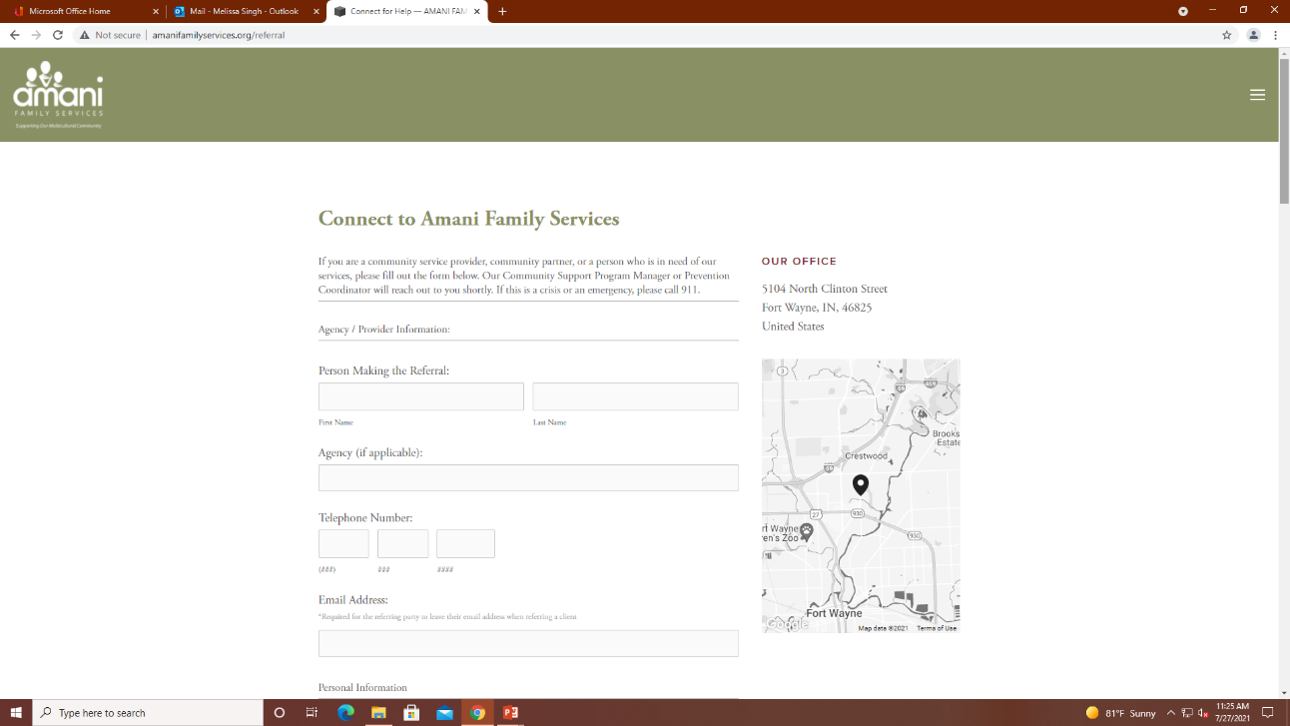
Connect to Services
Visit our website amanifamilyservices.org and click “Connect For Help”
Call 260-484-1414
Natalie Borjas, Prevention Coordinator
Melissa Singh, Associate Family Justice Director
nborjas@amanifamilyservices.org
msingh@amanifamilyservices.org

Slide 9
Questions

