Slide 1
Engaging Primary Care Providers in Interconception Care during Pediatric Visits
Emily Scott, MD FAAP

Slide 2
Acknowledgements
Funding provided by:
March of Dimes, Indiana
Riley Children’s Foundation

Slide 5
2020 MARCH OF DIMES REPORT CARD
PRETERM BIRTH RATES AND GRADES BY STATE
Hispanic
Preterm is less than 37 weeks gestation based on obstetric estimate.
Source: National Center for Health Statistics, 2018 final natality data.
MARCHOFDIMES.ORG/REPORTCARD

Slide 6
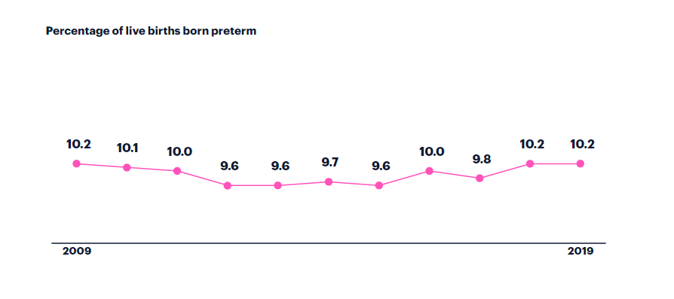
2020 MARCH OF DIMES REPORT CARD
Hispanic
Preterm is less than 37 weeks gestation based on obstetric estimate.
Source: National Center for Health Statistics, 2018 final natality data.
MARCHOFDIMES.ORG/REPORTCARD

Slide 7
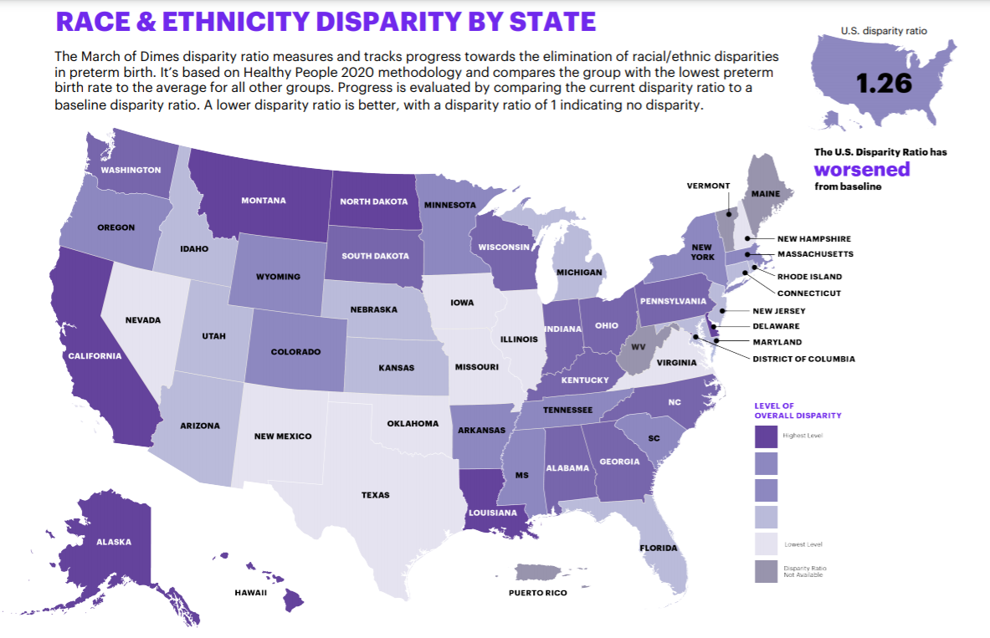
2020 MARCH OF DIMES REPORT CARD
PRETERM BIRTH RATES AND GRADES BY STATE
Hispanic
Preterm is less than 37 weeks gestation based on obstetric estimate.
Source: National Center for Health Statistics, 2018 final natality data.

Slide 8
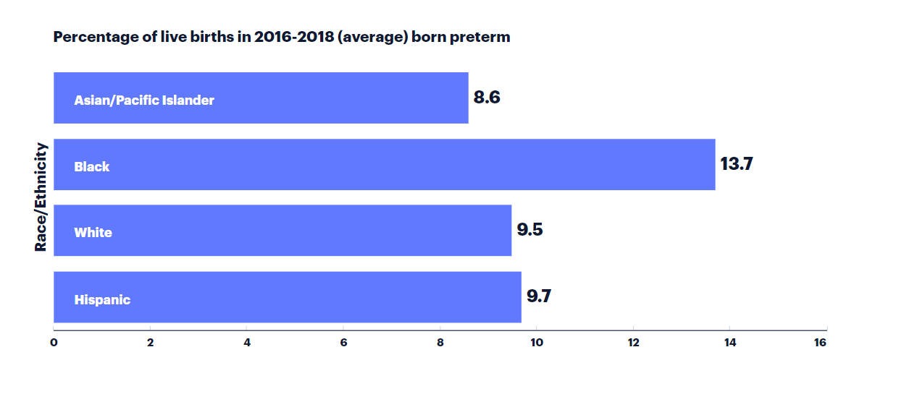
2020 MARCH OF DIMES REPORT CARD
INDIANA
Hispanic
Preterm is less than 37 weeks gestation based on obstetric estimate.
Source: National Center for Health Statistics, 2018 final natality data.
MARCHOFDIMES.ORG/REPORTCARD

Slide 9
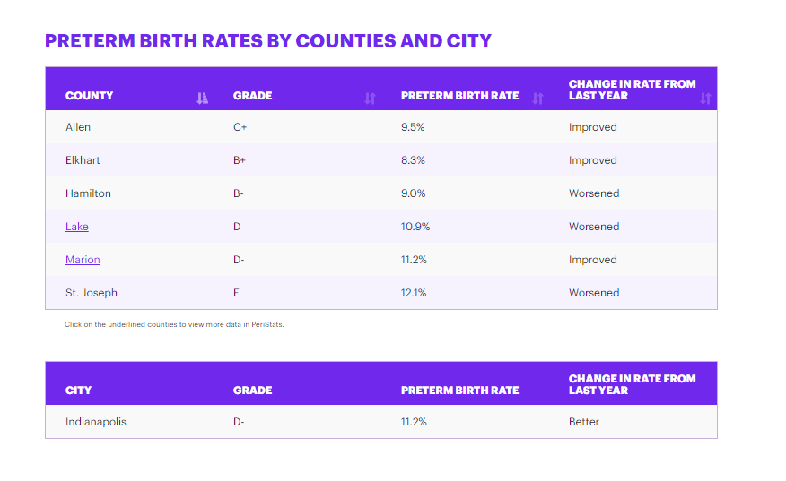
2020 MARCH OF DIMES REPORT CARD
PRETERM BIRTH RATES AND GRADES BY STATE
Hispanic
Preterm is less than 37 weeks gestation based on obstetric estimate.
Source: National Center for Health Statistics, 2018 final natality data.

Slide 10
What is interconception care?
Interconception care is defined as the care of a woman in between pregnancies – from the birth of one child to the conception of the next child.
Can have tremendous impact on subsequent pregnancy and birth outcomes
Can be a time when women do not receive preventive health care
Access to interconception care is impacted by racial disparities
Area of active interest – CDC Preconception Care Work Group
Notes:
Recommended for public health agencies to “maximize public health surveillance and related research mechanisms to monitor preconception health”

Slide 11
CDC’s 10 Preconception Health Indicators
Current smoking
Depression
Diabetes
Folic acid intake
Heavy alcohol consumption
6. Hypertension
7. Normal weight
8. Physical activity
9. Postpartum use of a most/ moderately effective method of contraception
10. Unwanted pregnancy

Slide 12
What is IMPLICIT ICC?
Interventions to Minimize Preterm and Low birthweight Infants through Continuous Improvement Techniques (IMPLICIT)

Slide 13
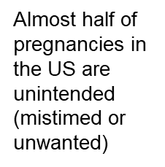
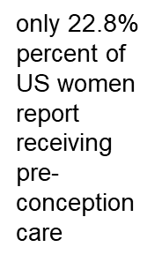
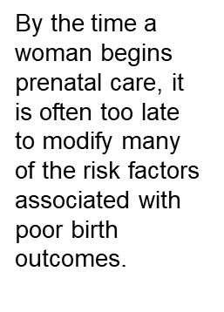
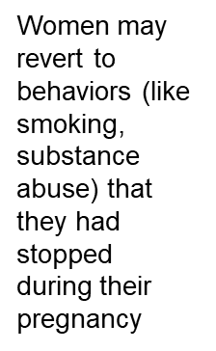
Why provide interconception care?

Slide 14
Targets women at their child’s well child visits
Targeted screenings/interventions have strong evidence for improving future birth outcomes
Screenings/interventions are brief and performable in the context of a well child visit
Enhances access to health care, especially for women who may not otherwise seek care

Slide 15
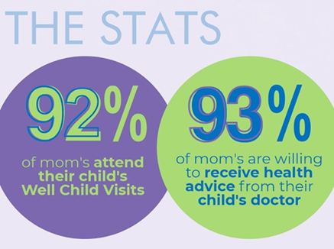
IMPLICIT – why focus on pediatric visits?
Maternal and family focus shifts from care of the pregnant woman to care of the infant.
Even if a mother doesn’t have her own primary care provider, most take their infants regularly to their pediatric visits.
Primary care pediatric providers interact with mothers more frequently than their own primary care provider or OB/GYN
8 well child visits in the baby’s first year of life

Slide 16
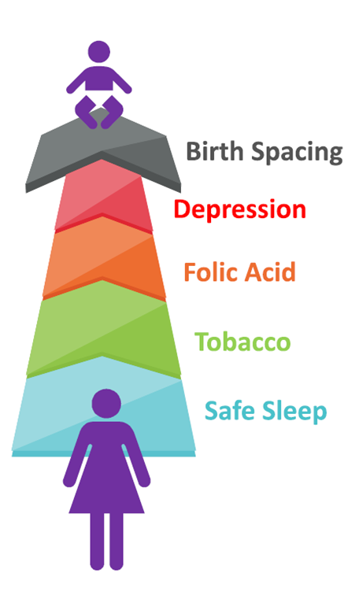
IMPLICIT Framework
Help moms have a healthy and appropriately spaced NEXT pregnancy while promoting the overall health of the family
Screening/Intervention for:
Tobacco use
Maternal Depression
Birth spacing plans
Use of Folic Acid
Safe sleep*

Slide 17
Pediatric Quality Improvement Learning Collaborative

Slide 18
Quality Improvement Learning Collaborative - 2019
8 Monthly Webinars
Data Review
Current PDSA cycles
Sharing ideas, resources
QI topic
Review of best practice recommendations
Kick-off Session
Overview of infant mortality in Indiana – the WHY?
IMPLICIT Interconception Care model
QI basics, current state process map

Slide 19
Two Pediatric Clinics – Marion County
Public Health Department
1 Pediatrician, 1 Family Medicine Physician, 1 FM Nurse Practitioner
Social work on site (but not always available)
OB/GYN on site
General Pediatric Subspecialty Clinic focusing on infant growth and development
2 Pediatricians
Social work embedded in clinic

Slide 20
Infant Mortality Champion
RN/LPN/MA leading multidisciplinary team in clinic
Met with project leader, QI coach weekly
Responsible for developing PDSA cycles, communicating with clinic team, collecting and entering data into database
0.1 FTE salary support

Slide 21
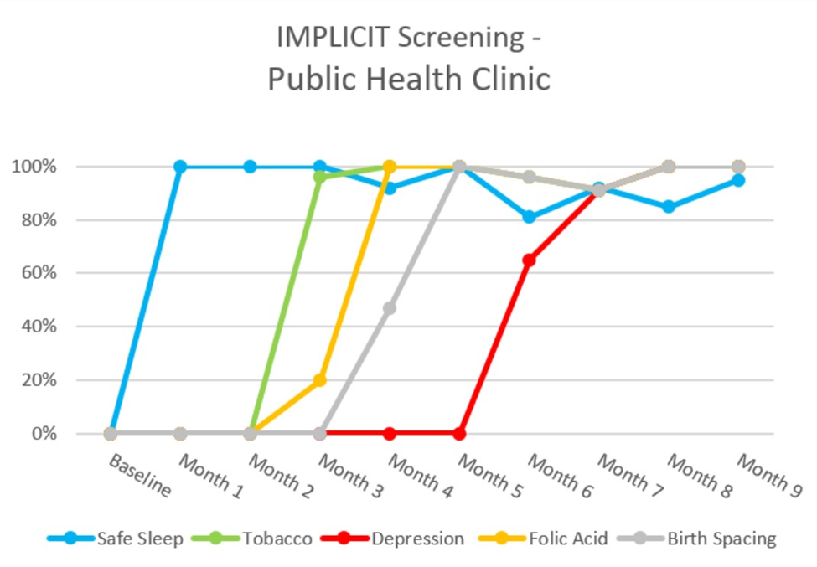

Slide 22
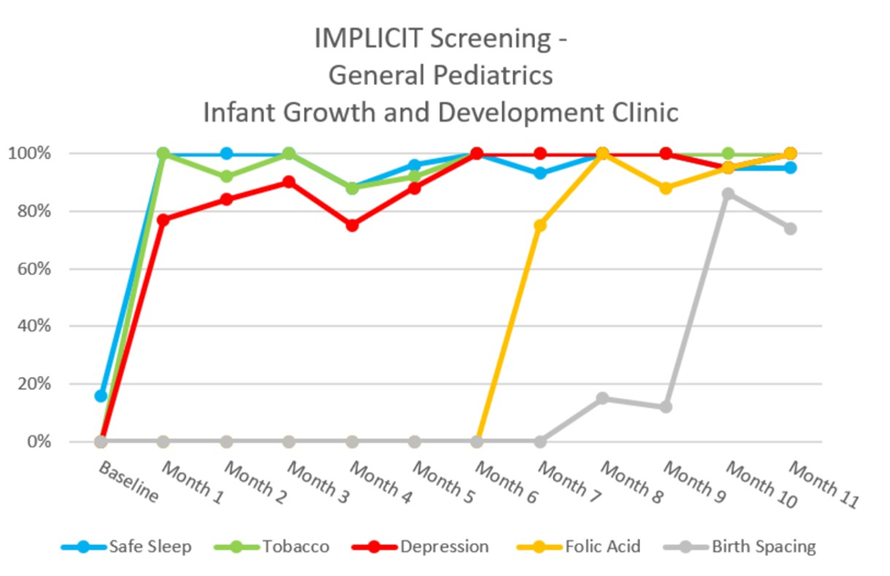

Slide 23
What was a positive “screen”
Any screen that needed an intervention –
Family reported baby was not sleeping safely at bedtime or naptime
Mom was using cigarettes or vaping
Mom was not taking MVI with folic acid
Mom did not desire a pregnancy in the next year and was not using a reliable for of birth control
Mom had a positive score on the PHQ9 or Edinburgh

Slide 24
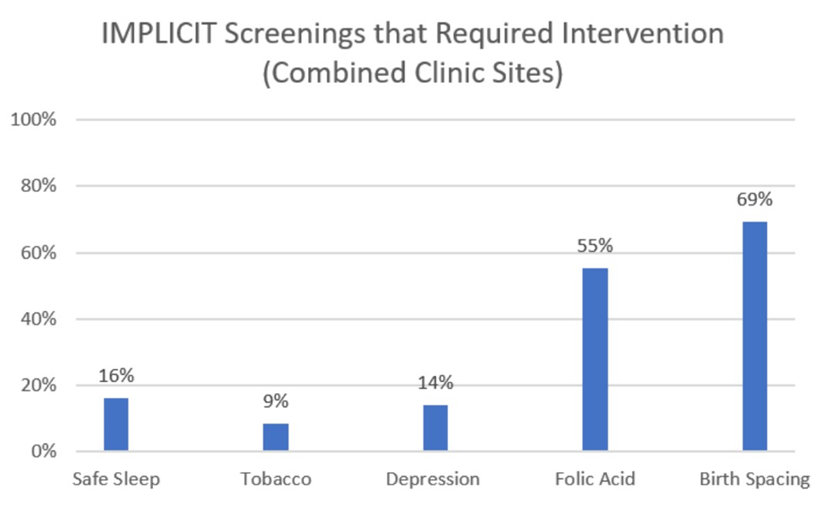

Slide 25
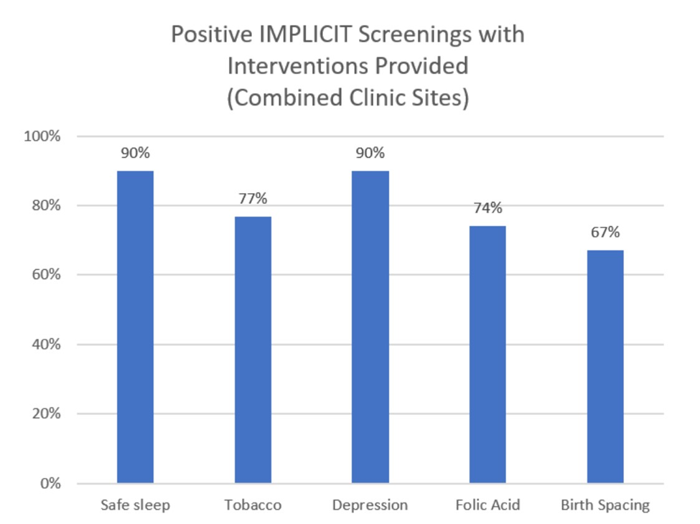

Slide 26
What made this feasible in pediatrics?
Adaptations:
Phased introduction of screening domains
Expansion of eligible visits
Scripting / seeking permission
Robust resources for interventions

Slide 27
You want us to do ALL of this?

Slide 28
Don’t try to boil the ocean…

Slide 29
Focus on what you can change by next week

Slide 30
Using QI methodology to guide our steps!
Setting a SMART Aim

Slide 31
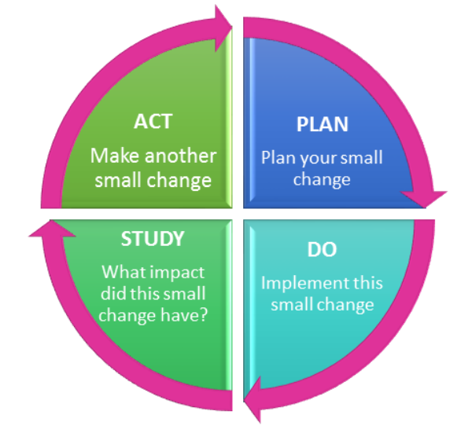
Using our PDSA cycles to guide the steps!
Plan: Who, what, when, where, how
Do
Study: Evaluate metrics
Act: Adapt, adopt or abandon!

Slide 32
Example: Tobacco screening
Aim: Screen 50% of eligible mothers for tobacco use by the end of next week.
Plan: MA will screen mother for tobacco use using a prompt in the electronic medical record when rooming the baby.
Do: Perform screening for 1 week.
Study: 7 out of 10 mothers were screened for tobacco use at the end of the week. This exceeds our 50% goal.
Act: Since this was successful, we will ADOPT this change.

Slide 33
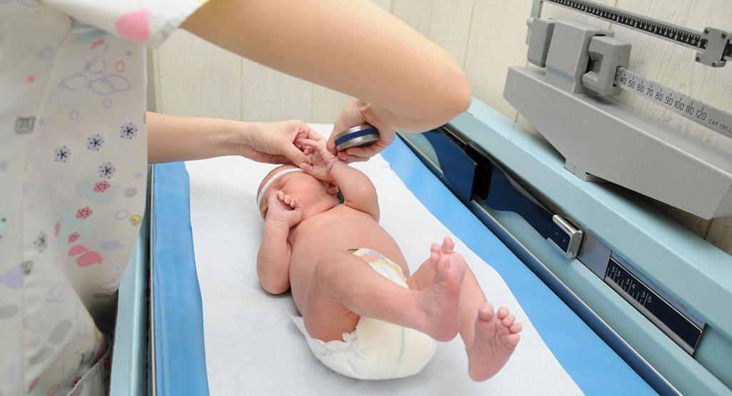
Expansion of eligible visits to include problem-focused visits

Slide 34
How do we ask about birth spacing?
https://www.envisionsrh.com/path-framework

Slide 35
How do we approach the tough questions?
Ask permission!
“We are interested in improving health outcomes for your family. We ask questions about your plans to grow your family. Is it okay if we ask those questions today, or would you prefer that we skip this section?”

Slide 36
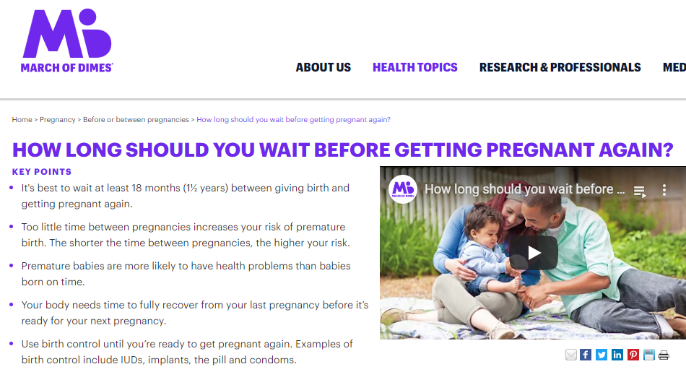
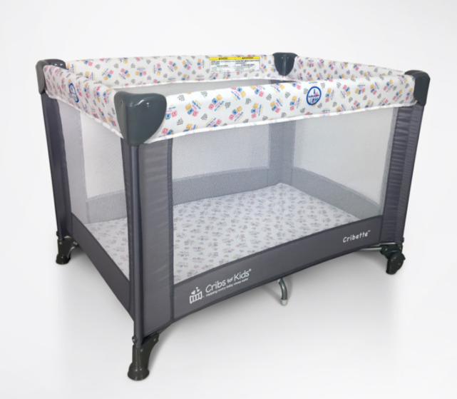
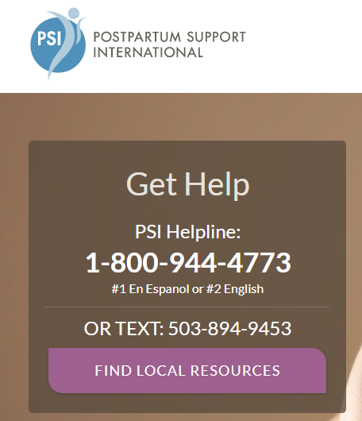
Resources:

Slide 37
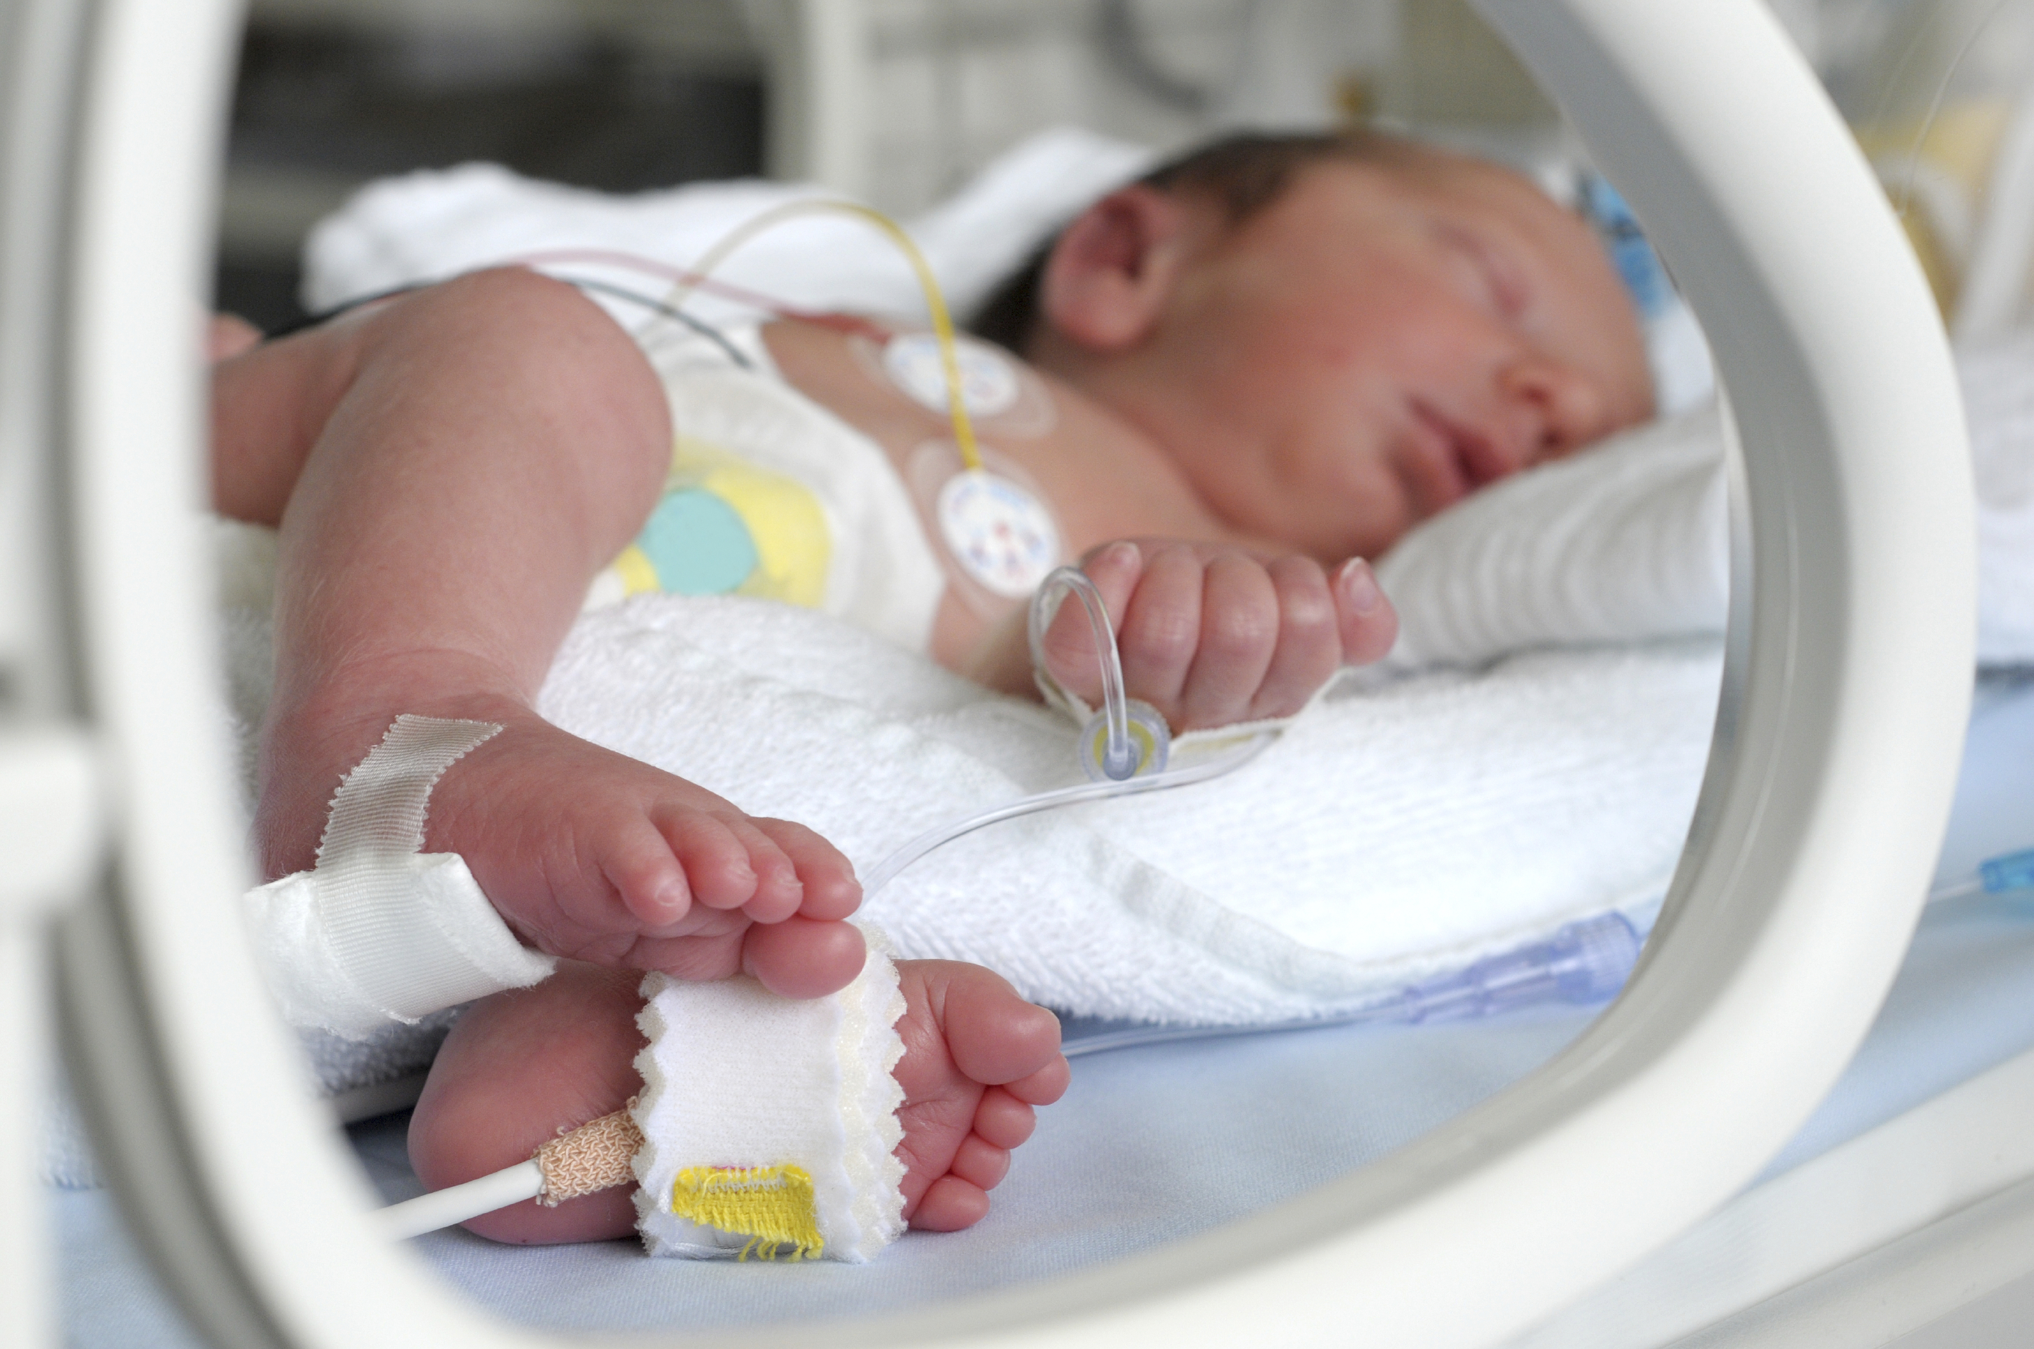
2020-2021 Cohort
Expansion into other area of pediatric medical care:
Neonatal Intensive Care Unit
Pediatric subspecialty clinic (Sickle Cell Disorder)

Slide 38
2020-2021 Cohort
Additional modifications needed:
When to screen when the baby is in the NICU?
How to incorporate home visiting programs?
How to do this all during COVID-19?

Slide 39
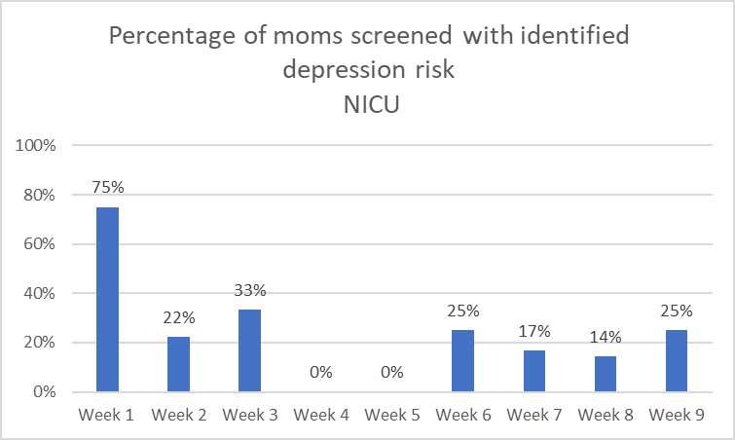
Early success!

Slide 40
Future Directions
Expansion to primary care clinics within Indiana
Family medicine
Pediatrics
Internal medicine
Expansion to inpatient units
Expansion to other sites where mothers receive services

Slide 41
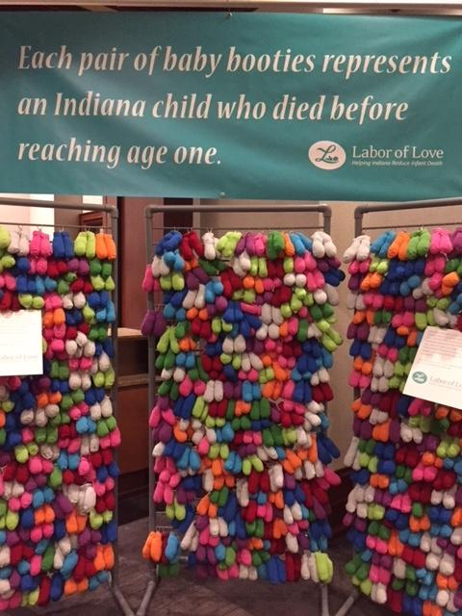
Supporting maternal and infant health is up to all of us!

Slide 42
Link to the IMPLICIT toolkit
https://www.marchofdimes.org/professionals/implicit-interconception-care-toolkit.aspx
Contact information:
Emily Scott, MD (pediatrics) – scotte@iu.edu

