Slide 1
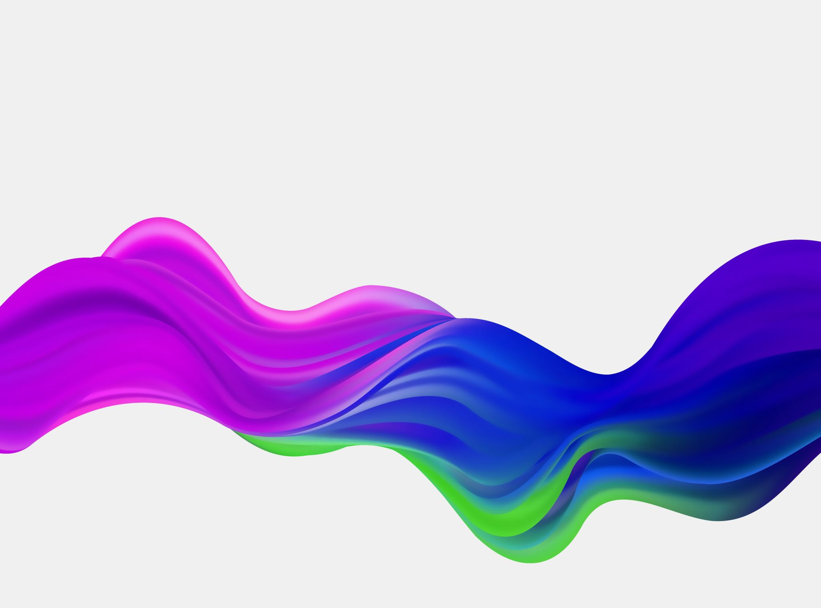
Perspectives on Implicit Bias in Maternal Healthcare
Lauren Dungy-Poythress, MD
Associate Professor
Division of Maternal-Fetal Medicine
Indiana University School of Medicine

Slide 2
What is Implicit Bias?
Imagine coming in out of a cold freezing rainstorm
Would you rather sit next to the blue or the red fireplace

Slide 3
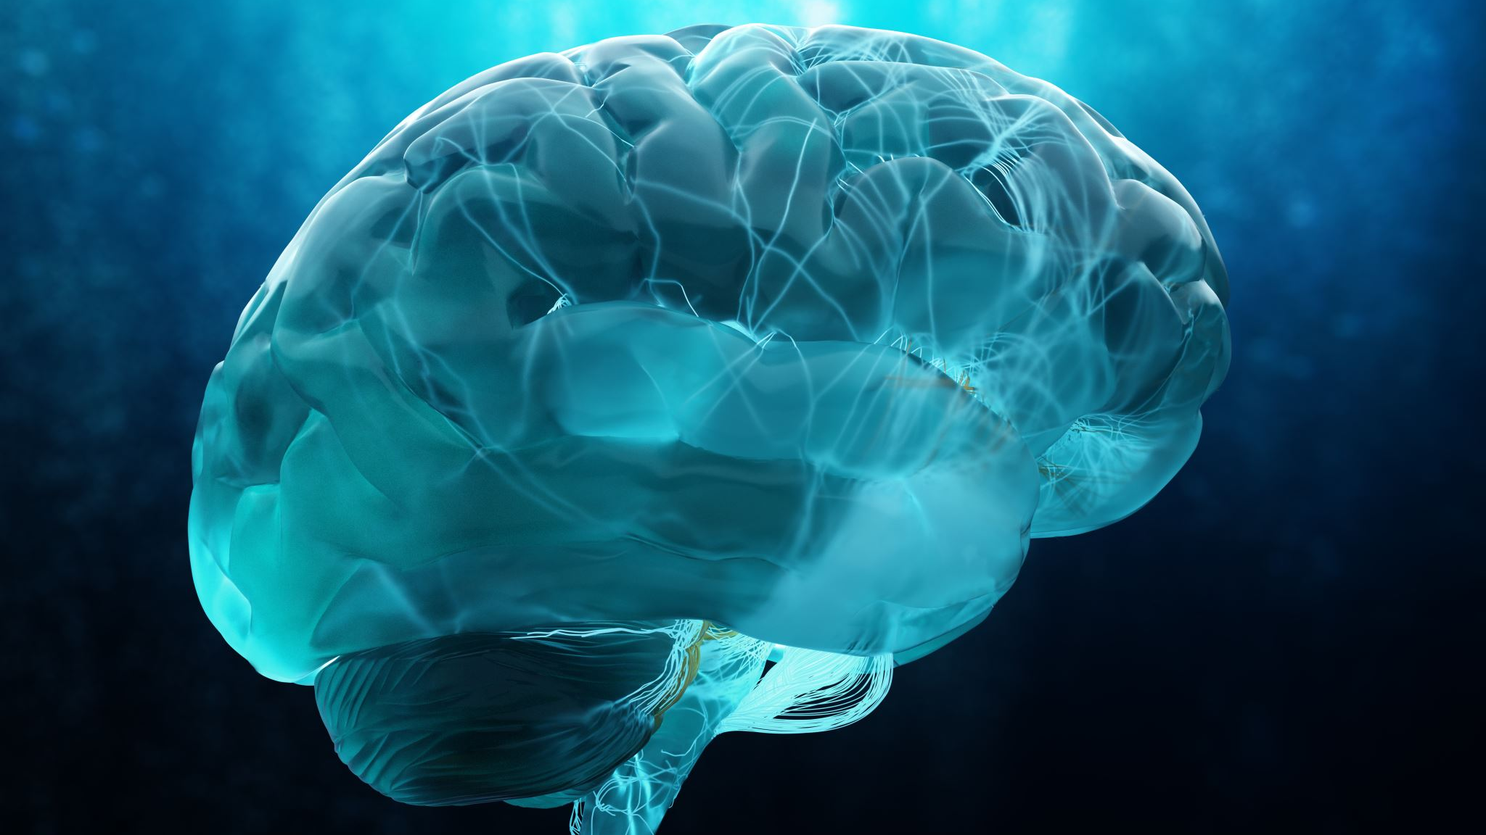
What is Implicit Bias?
The ability to rapidly categorize every person or thing we encounter is thought to be an evolutionary development to ensure survival
Humans needed to quickly decide whether something or someone was friendly or dangerous
Our brains still use these shortcuts
Unfortunately, sometimes to the detriment of others

Slide 4
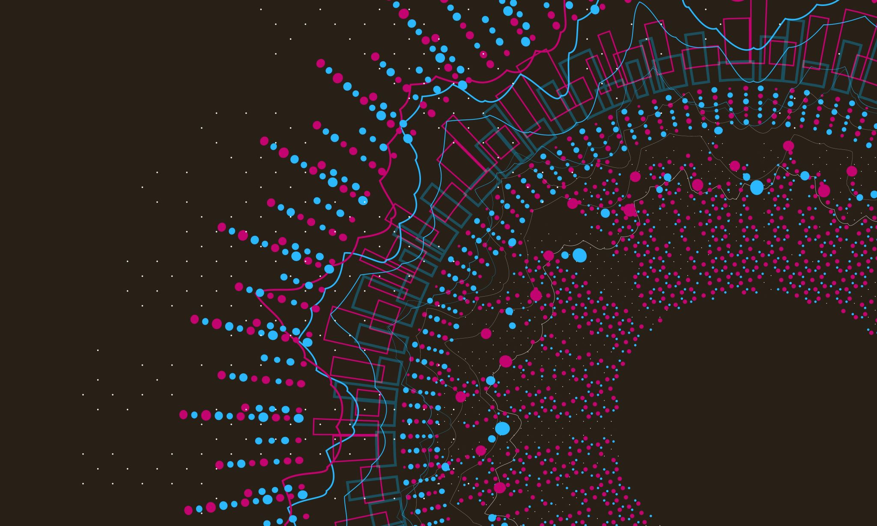
Implicit Bias
Attitudes, thoughts, and feelings that exist outside of conscious awareness
Thus -- difficult to consciously acknowledge and control
These attitudes are often automatically activated and can influence human behavior without conscious volition

Slide 5
Why Do We Care??
Why do we care about implicit bias in healthcare

Slide 6
Why Do We Care About Implicit Bias in Healthcare??
Implicit attitudes about patients may contribute to disparities in healthcare outcomes
Racial
Gender
Disability
SES
Obesity
Other
Professionals may say that they try to treat all patients equally and may not believe they hold negative attitudes about patients
By definition, we lack awareness of our unconscious biases and our actions often unknowingly suggest that these biases are active
Covert discrimination and institutional bias may be sustained by subtle implicit attitudes that may influence provider behavior and treatment choices
Chair in waiting room
“No bonnets” in Columbus, Ga.
Pictures in advertising

Slide 7
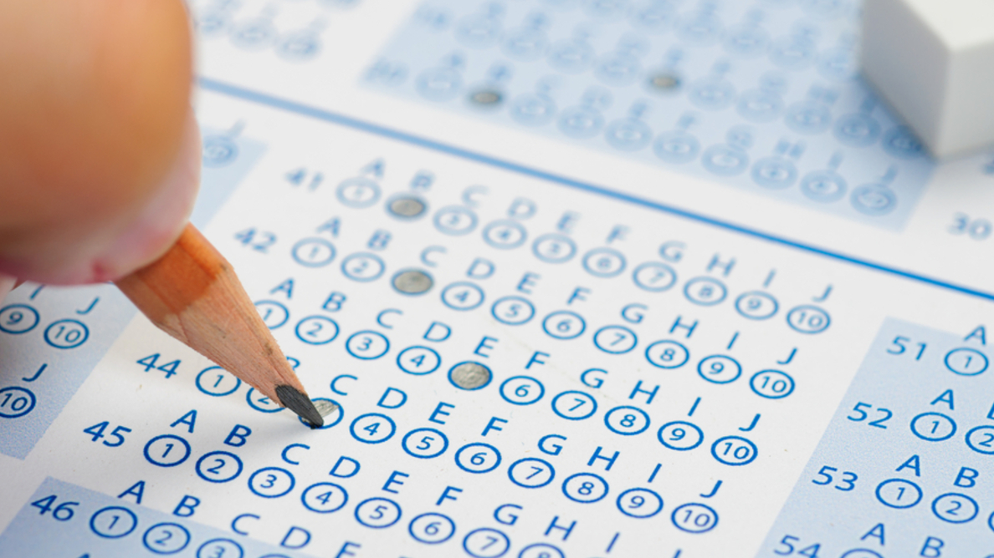
Implicit Aptitude Test (IAT)
Developed in 1998
Calculates how quickly people associate different terms with each other
Category of pairs that are unconsciously preferred are easier to sort (and therefore, take less time) than those that are not preferred
e.g., sort pictures of black and white people with words (good or bad) into pairs.
Based on the reaction times needed to perform these tasks, the software calculates a bias score
Despite limitations and criticisms of IAT, critics do not refute the existence of unconscious bias or that it can influence life experiences
According to Project Implicit (Harvard)
The Race IAT has been taken > 4 million times
75% of test takers demonstrate an automatic white preference
Meaning that most people (including a small group of black people) automatically associate white people with “goodness” and black people with “badness”
The extent to which the IAT predicts behavior is unclear
These preferences do not necessarily mean that an individual expresses outward expressions of negative attitudes towards different social groups

Slide 9
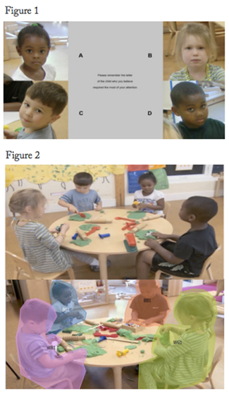
Implicit Biases in Childhood (Extend Into Adulthood)
Researchers led by Yale professor showed 135 educators videos of children in a preschool classroom setting
Groups of 4 (2 boys and 2 girls; 2 black and 2 white)
The teachers were asked to detect “challenging behavior”
No such behavior existed in any of the videos
Yet, when asked which children required the most attention, 42% of the teachers identified the Black boy
Independent results of an eye-tracking technology also noted that preschool teachers “show a tendency to more closely observe Black students, and especially boys, when challenging behaviors are expected”
Theconversation.com A. Cooke, et al. July 21,2020

Slide 10
Implicit Biases in Childhood (Extend Into Adulthood)
New teachers mistakenly assume Black students are angry”
Teachers in training watched videos of the children and were asked to identify the emotion they saw
72 Black and White child actors trained by experts to make specific facial muscle movements
Study showed that teachers are prone to mistakenly see anger where none exists in Black children
36% more likely
They were absolutely trained to make the same facial expressions
Research demonstrates that Black children are viewed as 4-5 years older than they are
Theconversation.com A. Cooke, et al. July 21,2020

Slide 11
Why It Matters??
Previously, the researchers had determined that college students who aspire to become teachers were more likely to misread Black adults’ emotions, as compared to sensing what white adults are feeling, and that they mistakenly believe that Black adults are angry when they are not feeling angry
This study showed that teachers are prone to mistakenly seeing anger where none exists in Black children as well
Black children are 3-4X more likely to be suspended or expelled from school than their white classmates
This problem begins early- before children even make it to kindergarten
Black children also tend to feel less understood by their teachers than white children
The potential consequences of poor relationships between students and their teachers and school discipline can be long-term and last well into adulthood
Theconversation.com A. Cooke, et al. July 21,2020

Slide 12
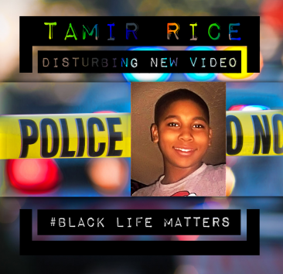
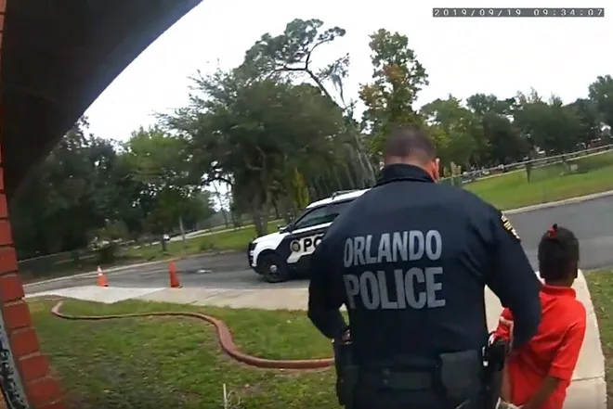
Why It Matters??
Police officers fatally shoot 12-year old
Tamir Rice playing with toy gun in park
Teachers are not the only adults who mistakenly
see Black children as angry and overreact
Sometimes the consequences are tragic
“Fellow cops shared concerns during
Orlando officer’s handcuff and arrest of
6-year-old at elementary school after tantrum”
-Orlando Sentinel

Slide 13
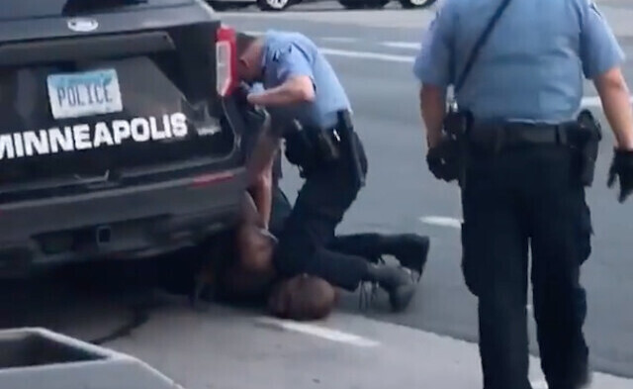
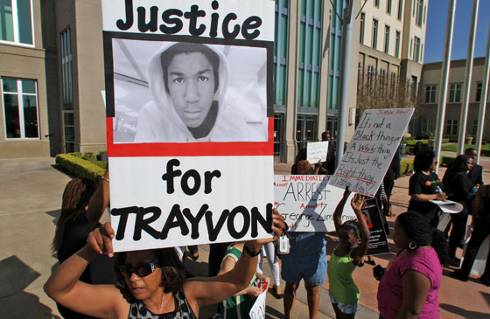
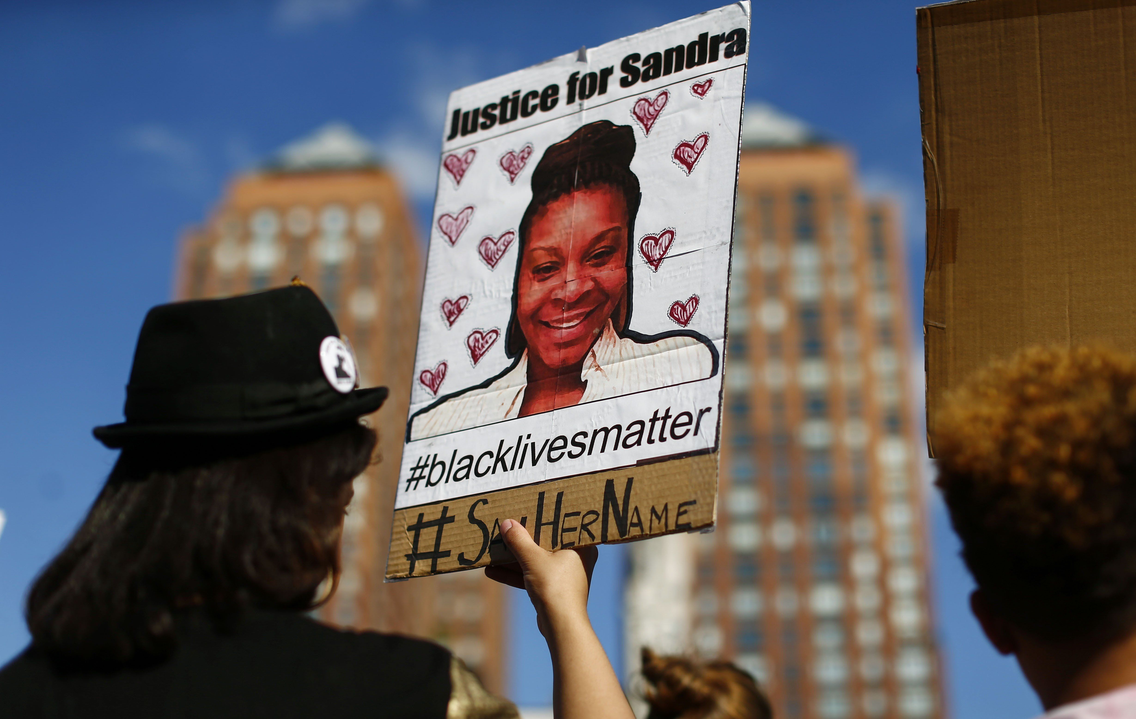
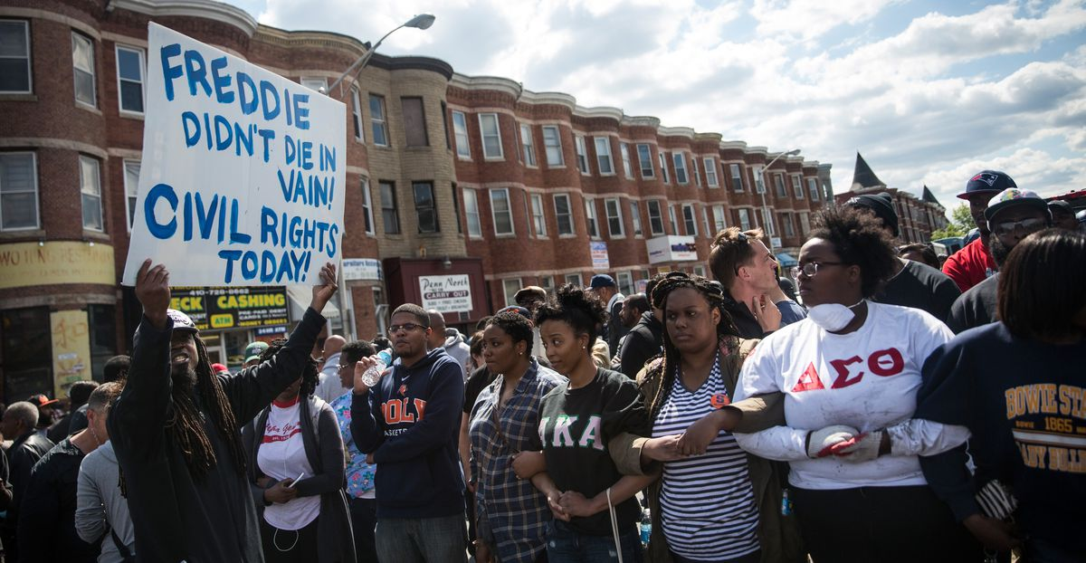
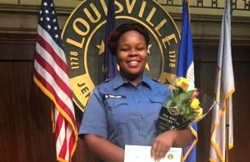
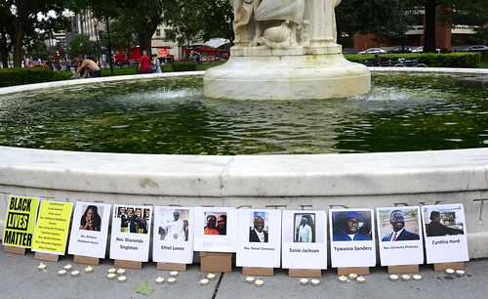
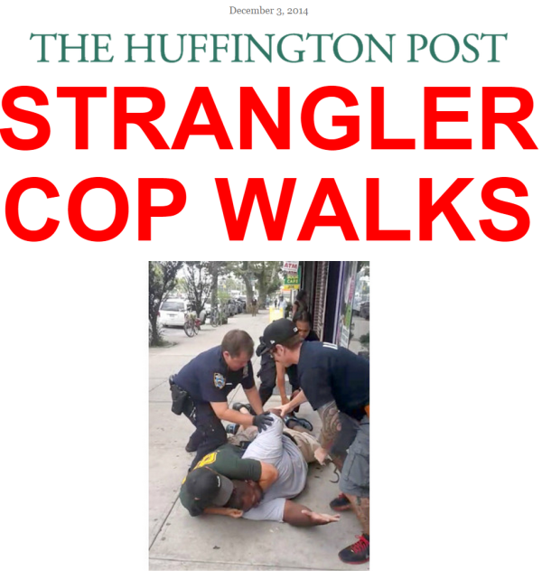
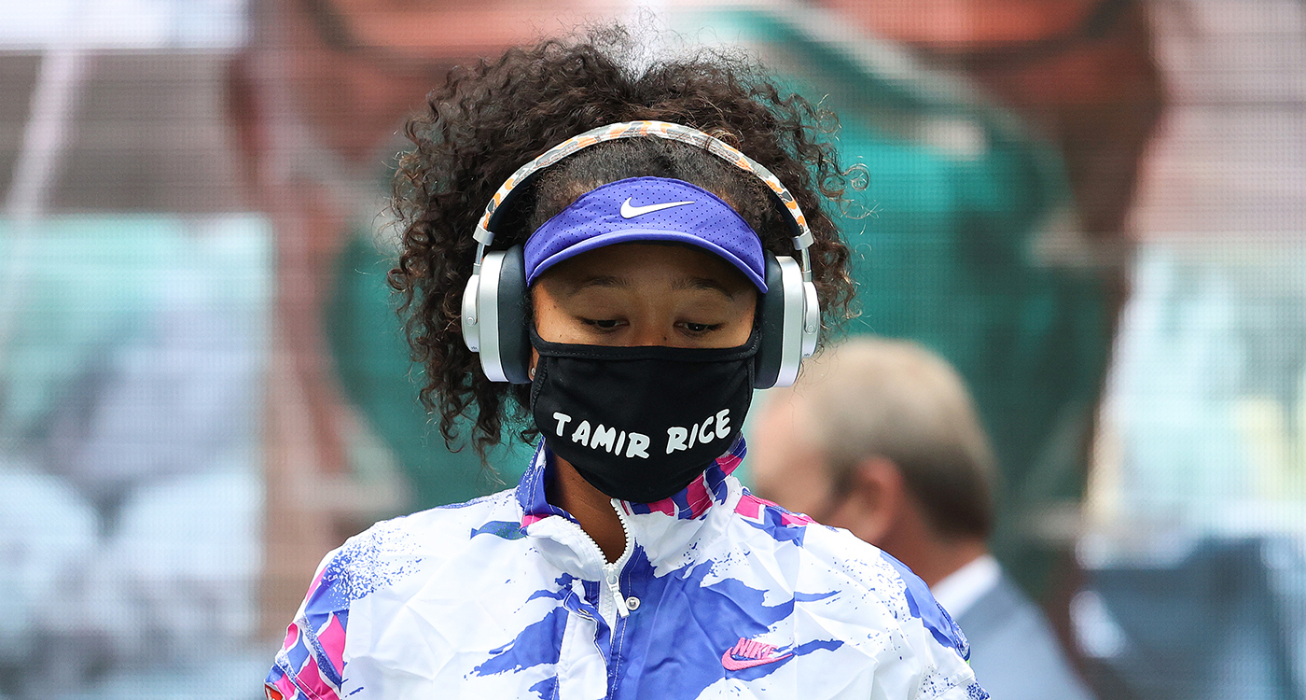
Racism, Hate Crimes, Dehumanized, Devalued

Slide 14
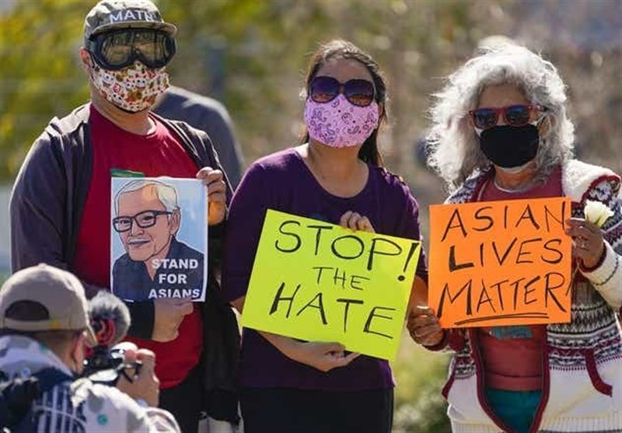
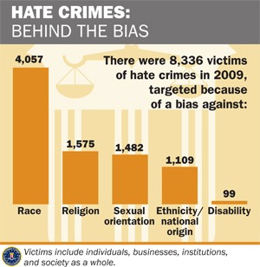
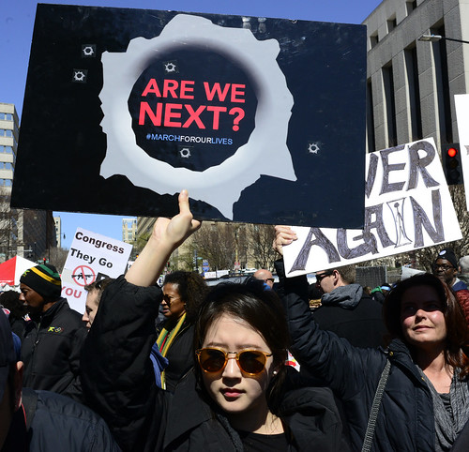
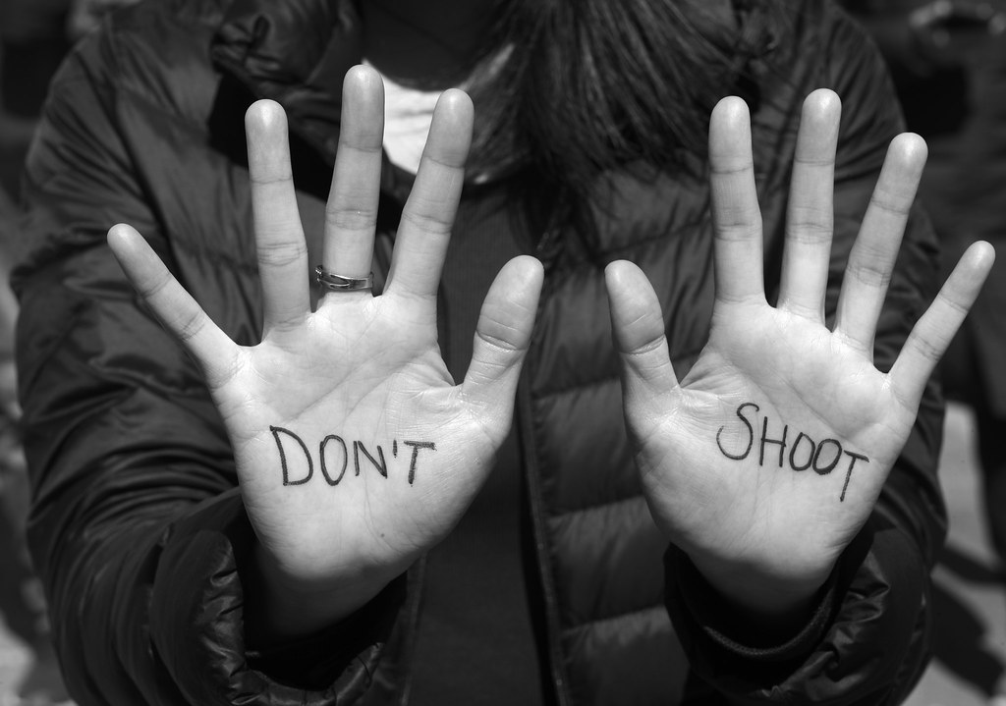
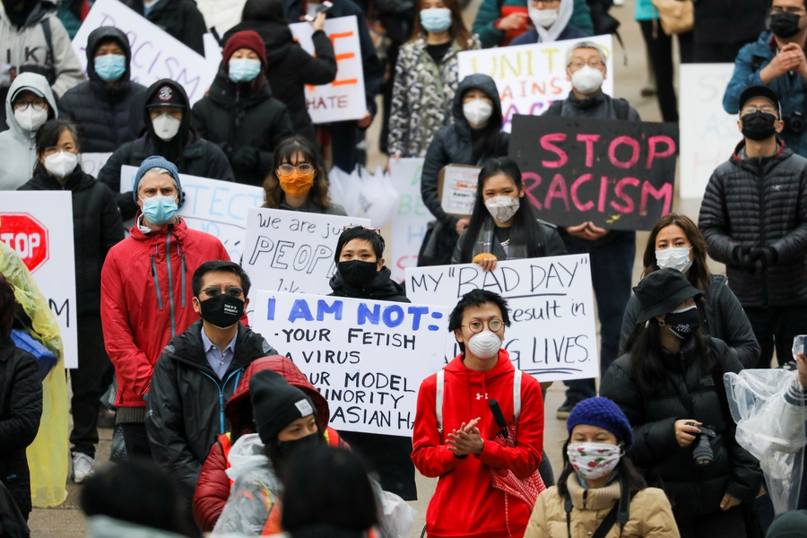
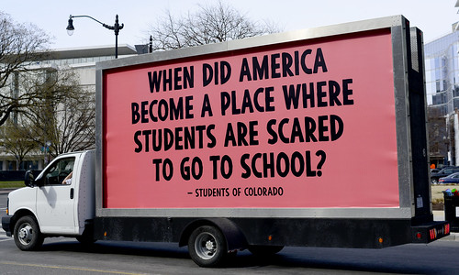
Racism, Hate Crimes, Dehumanized, Devalued

Slide 15
Social Factors Affecting Health
Maternal Health
Community Safety
Social Service Resources & Support
Employment/ Work Environment
Housing
Transportation
Food Stability
Air/Water Quality
Police Brutality
Implicit Biases
Microaggressions
Hate Crimes
Personal/ Family/ Friend Experiences
Income
Government Policies (Social, Economic, Health)
Domestic Violence
Neighborhood/ Environment
Education
Racism

Slide 16
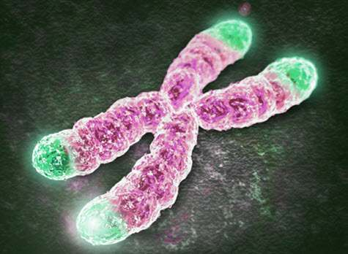
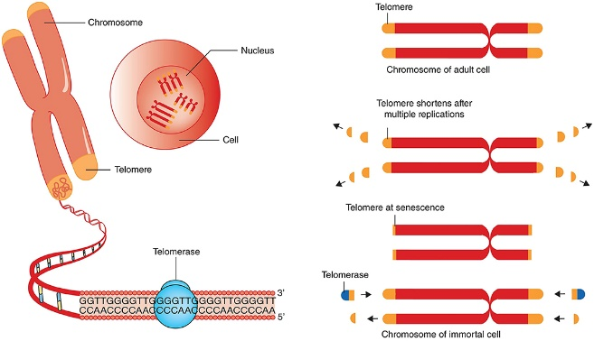
Stress Factors Affecting Health
Maternal Health
Community Safety
Social Service Resources & Support
Employment/ Work Environment
Housing
Transportation
Food Stability
Air/Water Quality
Police Brutality
Implicit Biases
Microaggressions
Hate Crimes
Personal/ Family/ Friend Experiences
Income
Government Policies (Social, Economic, Health)
Domestic Violence
Neighborhood/ Environment
Education
Racism
Weathering Concept
Stressors-- such as transportation worries, food insecurity, state of fear -can wear the human body down at the cellular level, affecting the cardiovascular, immune and metabolic systems.

Slide 17
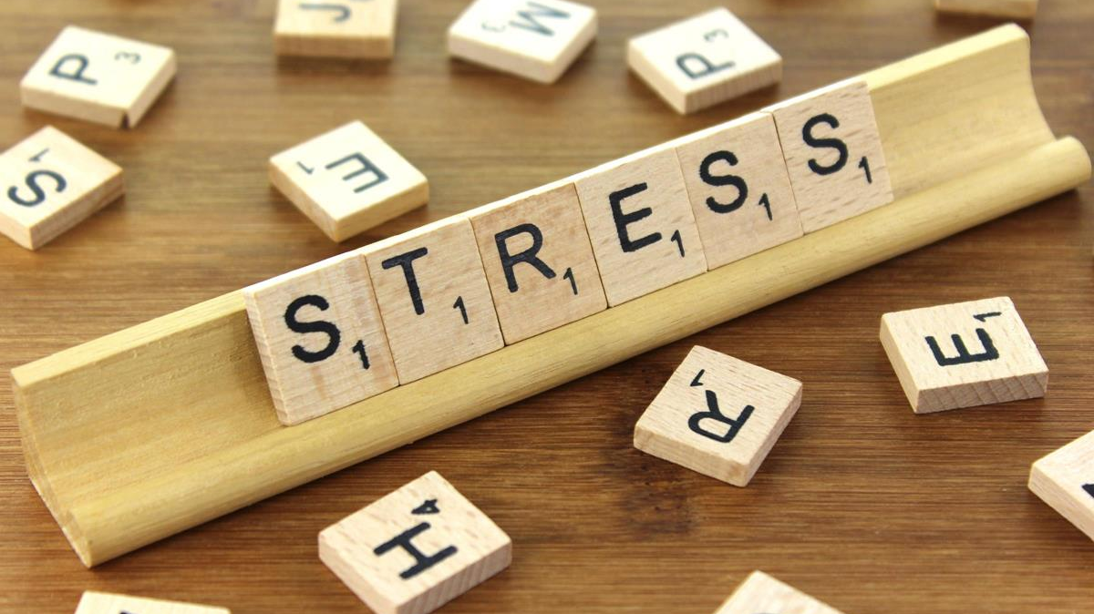
Weathering
“Chronic stress puts the body into overdrive. It’s the same idea as if you keep gunning the engine, that sooner or later you’re going to wear out the engine”. . .
. .“As women get older, birth outcomes get worse.
If that happens in the 40s for white women,
it actually starts to happen for African-American
women in their 30s.”
“The stress of being a Black woman in American society
can take a physical toll during pregnancy and childbirth.”
- Michael Liu (former head of Mat Child Health Bureau)

Slide 18
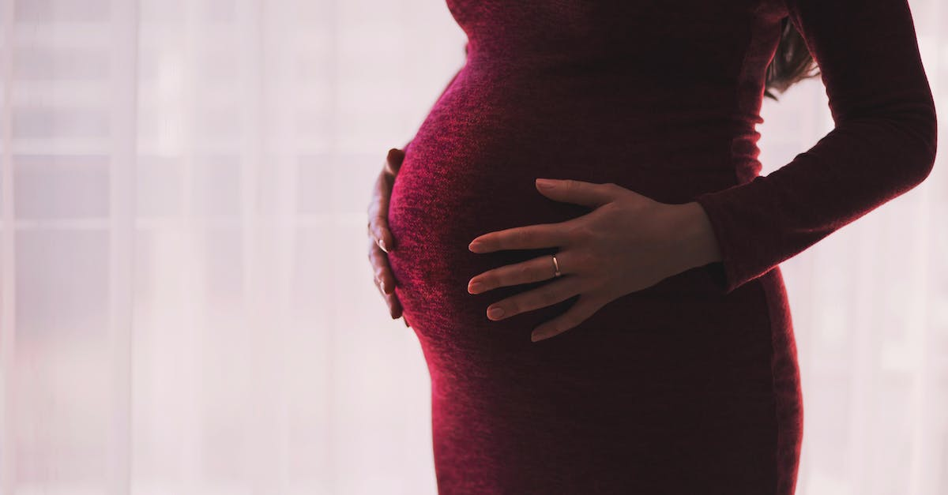
Racial Disparities in Women’s Health
Black vs White women
More likely to die from cervical cancer (10%)
More likely to die from breast cancer (40%)
More likely to die from endometrial cancer (50%)
Perinatal Medicine
PTB rates 40% greater in Blacks vs Whites
Maternal mortality 3-4 times greater in Blacks vs Whites
Severe maternal morbidity rates 20% greater in Blacks vs Whites
Readmission to hospital after delivery 80% higher in Blacks vs Whites
16% higher morbidity in Blacks vs Whites when readmitted

Slide 19
SMFM Position Statement
January 2017; reissued in 2020
The Society for Maternal-Fetal Medicine (SMFM) is deeply concerned with racial and ethnic disparities in health outcomes and health care during pregnancy, childbirth, and the postpartum period. Disparities are both pervasive and well-described, with a disproportionate burden of disease borne by non-Hispanic Black women and other women of color
SMFM, therefore, strongly encourages maternal-fetal medicine (MFM) physicians to be conscious of social determinants of health and inequality; to pursue training in implicit bias and cultural humility; and to ultimately work towards a goal of health equity addition,
SMFM strongly recommends that this training, as well as training in health policy and advocacy skills, be incorporated formally into all MFM fellowship curricula. As an organization, SMFM is equally committed to such goals and will advocate for improved health outcomes for disadvantaged populations

Slide 20
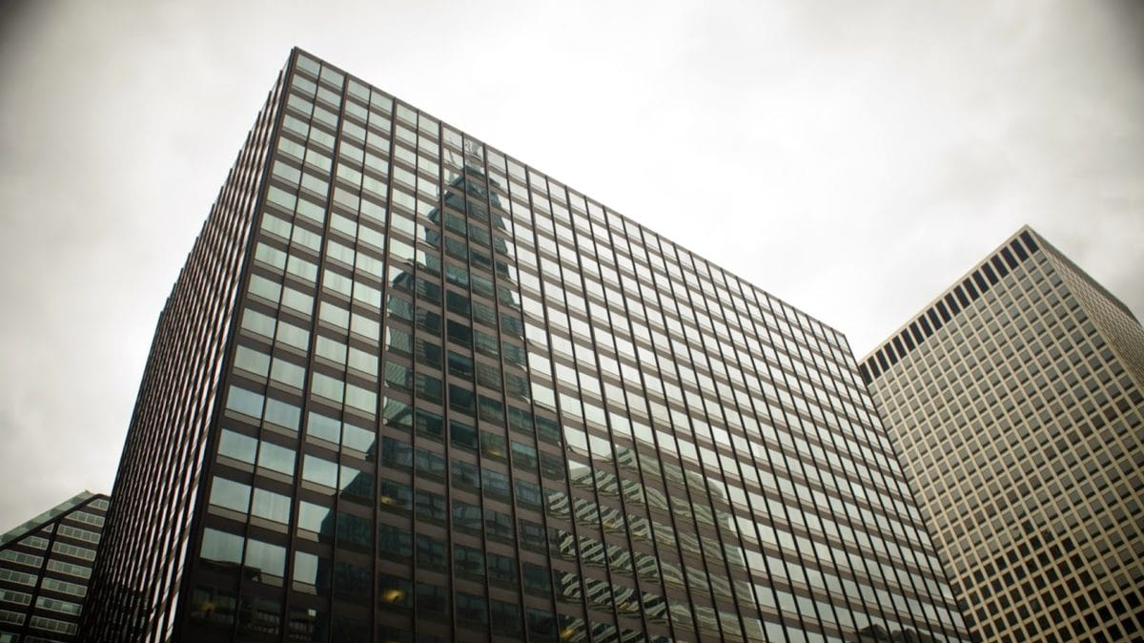
Statement of Policy - ACOG
Racism is defined as behavior, attitudes, and actions that reflect the belief that racial differences produce an inherent superiority of a particular race as well as the systemic oppression of a racial group to the social economic and political advantage of another. Racism, not race, drives health inequities and leads to adverse health outcomes. . . .
Race is a social category, not a biological or genetic condition . . . Racial health inequities are the result of the upstream and downstream impacts of systemic racism on the lives, health and wellbeing of Black, Indigenous, Hispanic/Latino, Asian, Native Hawaiians, Pacific Islanders and other historically marginalized populations. . . .
Racial and ethnic inequities in obstetrics and gynecology cannot be reversed without addressing all aspects of racism and racial bias . .
February 2022

Slide 21
Examples of Implicit Bias in Healthcare
Patients seen in the ER
Black patients seen in ER departments receive less analgesia than White patients
Hispanic patients in one study were 7 times
less likely to receive opioids in the ER than non-Hispanic patients,
even in the presence of severe injuries
Chapman, et al, J Gen Intern Med 2013

Slide 22
Examples of Implicit Bias in Healthcare
Pediatricians provided with identical vignettes randomly identifying a patient as either Black or White
Underwent IAT
Providers who had a high degree of implicit pro-White bias were significantly more likely to disagree with the standard of care and provide opioid analgesics to the patient
J Appl Psychol 2015

Slide 23
Examples of Implicit Bias in Healthcare
Marginalized populations such as homeless or people of color
Presumed more likely to be non-compliant with their medications
Presumed more likely to be medication-seeking or having an ulterior motive when seeking care
(e.g., sickle cell patient)
Hoffman, et al Proc Natl Acad Sci 2016

Slide 24
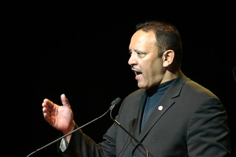
NPR /Harvard/Robert Wood survey-2017
Problems are amplified by unconscious biases that are embedded in the medical system, affecting quality of care
33% of black women said they had been discriminated against because of their race when going to a health doctor or clinic
21% said they had avoided going to a doctor or seeking health care due to concerns of racial discrimination
Implicit Biases, Marginalization,
Discrimination, Being Ignored
Marc Morial – President and CEO, National Urban League
2022 Equality Index
Expressed that Black Americans are “frustrated and worried
about being discriminated against because of their race”
“Black Americans particularly ‘feel the sting or racism’ in the
healthcare system”
The Index revealed:
An overwhelming 8 in 10 Black respondents feel that race influences the quality of care a person receives
2 in 5 respondents said the system had discriminated against them personally

Slide 25
Implicit Biases, Marginalization, Discrimination, Being Ignored
“About a third of our population is African-American. African-Americans have a higher incidence of maternal mortality. So if you correct our population for race, we’re not as much of an outlier as it would otherwise appear. Now, I say that not to minimize the issue, but to focus the issue as to where it would be. Um, for whatever reason, people of color have a higher incidence of maternal mortality. ”
- Senator Bill Cassidy (R-LA)

Slide 26
Serena Williams
History of pulmonary embolism
Pregnancy
C-section

Slide 27
Shalon Irving
Lieutenant commander, US Public Health Service
PhD, MPH, MS, CHES
Epidemiologist with the CDC
C-section at 37 weeks’ (fibroid surgery)
2 weeks after surgery
Incision pain/drainage
Home visiting nurse
BP 174/118 mmHg
At office BP lower and labs normal
Sent home
5 days later returned
9 lb weight gain in 10 days
Edema to above the knees
“Didn’t feel well”
“You just had a baby. Give it time”
3 weeks after delivery
Given Rx for hypertension
Picked up medicine at pharmacy - then went to dinner with her mother and baby
“I don’t care what they say. I know my body. Something’s not right”
Cardiac arrest and collapsed. Died later at the hospital.
Autopsy -$4500.00 in another county – Hypertensive disease of the heart

Slide 28
Charles Johnson IV
Wife (Kira) died 10-12 hours after “botched” scheduled C-section
17 minutes
Bled internally throughout the day
3.5 liters of blood in her abdomen
Attempts to advocate for her care by husband
and family were repeatedly ignored
Told by staff - ”your wife is not a priority right now”
Kira repeatedly asked him to calm down - fears of
being labeled an ”angry Black man”
Charles Johnson sued Cedars Sinai Hospital
citing racism as the cause of his wife’s death

Slide 29
W.E.B. Du Bois
”The problem of the Twentieth Century is the problem of the color line . . . The relation of the darker to the lighter races of men in Asia and Africa, in America and the islands of the sea.”
1903

Slide 30
Racial Identity Development
Integrative
Awareness
Understanding
White Privilege
Guilt
Shame
White People
Blaming
Reverse Racism
Understanding Complex Identity
Intersectionality
Acceptance
Dismissive
Angry
Bitter
Dissension
Disillusioned
Conformity
Confused
People of Color
Emulate
Whiteness
Conformity

Slide 31
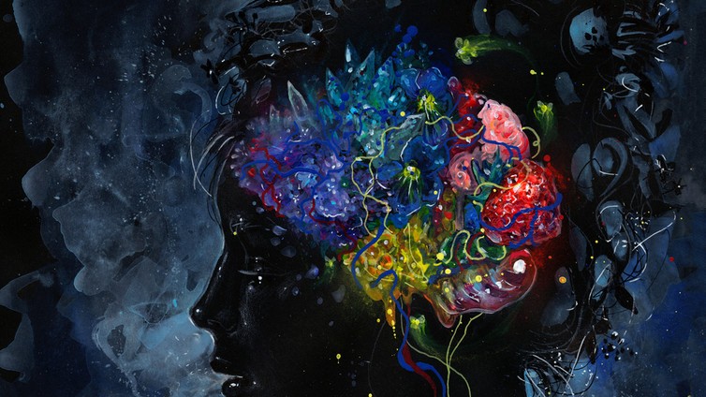
Why Do We Care About Implicit Bias in Healthcare????
Implicit biases:
Can compound social/stress factors affecting health
and contribute to racial health disparities
May be better understood as a cognitive manifestation of historical and structural/organizational inequalities, rather than solely a feature of individual mindsets
Suggests that efforts to remediate implicit bias require attention be given to modifying social environments, and not solely to changing the attitudes of individuals
Addressing these issues may mitigate disparities in health outcomes

Slide 32
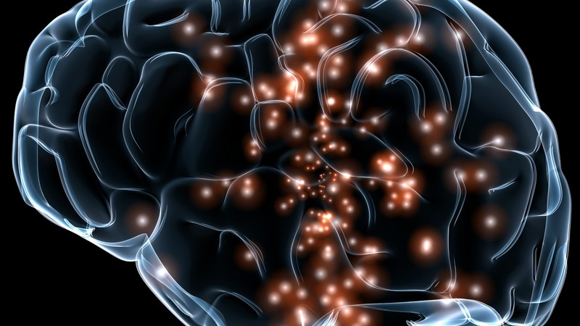
Summary: Implicit Bias in Healthcare
Whether bad or good, justified or unjustified, our beliefs and attitudes can become automatically triggered, affecting our behavior and decision making
It can happen -
-unintentionally
-unconsciously
-without effort
-in a matter of seconds
It can happen -
-irrespective of our values
-irrespective of what kind of person
we desire to be

Slide 33
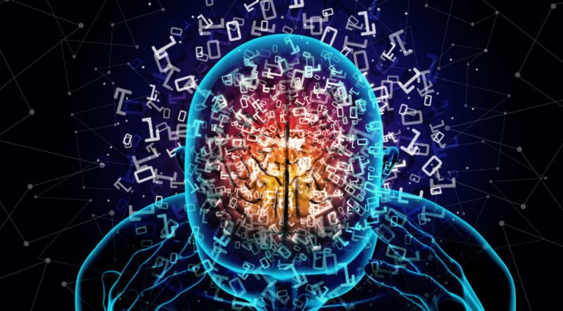
Implicit Bias in Healthcare
Efforts to mitigate implicit biases that negatively affect healthcare require:
Deliberate intention
Focused attention
Persistent mindfulness
Individual level
Organizational level
“Deconstructuring our unconscious bias takes consistent work.
We can’t address it once and be done. We need to recognize these unwanted, deep-rooted beliefs and limit their influence on us.”
- Sarah Fiarman

Slide 34
“The only thing necessary for the triumph of evil is for good men to do nothing.”
Edmond Burke

Slide 35
I am only one, but I am one. I cannot do everything, but I can do something. . . . .and I will not refuse to do the something that I can do.
Edward Everett Hale

Slide 36
Perspectives on Implicit Bias in Maternal Healthcare
Lauren Dungy-Poythress, MD
Associate Professor
Division of Maternal-Fetal Medicine
Indiana University School of Medicine

Slide 38
Perspectives on Implicit Bias in Maternal Healthcare
Lauren Dungy-Poythress, MD
Associate Professor
Division of Maternal-Fetal Medicine
Indiana University School of Medicine

Slide 39
Racial Identity Development
Integrative
Awareness
Understanding
White Privilege
Guilt
Shame
White People
Blaming
Reverse Racism
Understanding Complex Identity
Intersectionality
Acceptance
Dismissive
Angry
Bitter
Dissension
Disillusioned
Conformity
Confused
People of Color
Emulate
Whiteness
Conformity

