Slide 1
PIC Luncheon 12/7/2023
Cori McKenzie MSW

Slide 2
Introduction to Bereavement Coordination
Meet with patients in the hospital setting at the time of the loss in the OB unit or NICU to provide emotional support, education, keepsakes, and resources
Plan and prepare alongside families who carry a pregnancy with limited life expectancy or a fatal diagnosis
Provide follow-up care and visits to meet ongoing needs
Facilitate support groups and peer support program
Focus on trauma reduction during a highly stressful time
PALS support

Slide 3
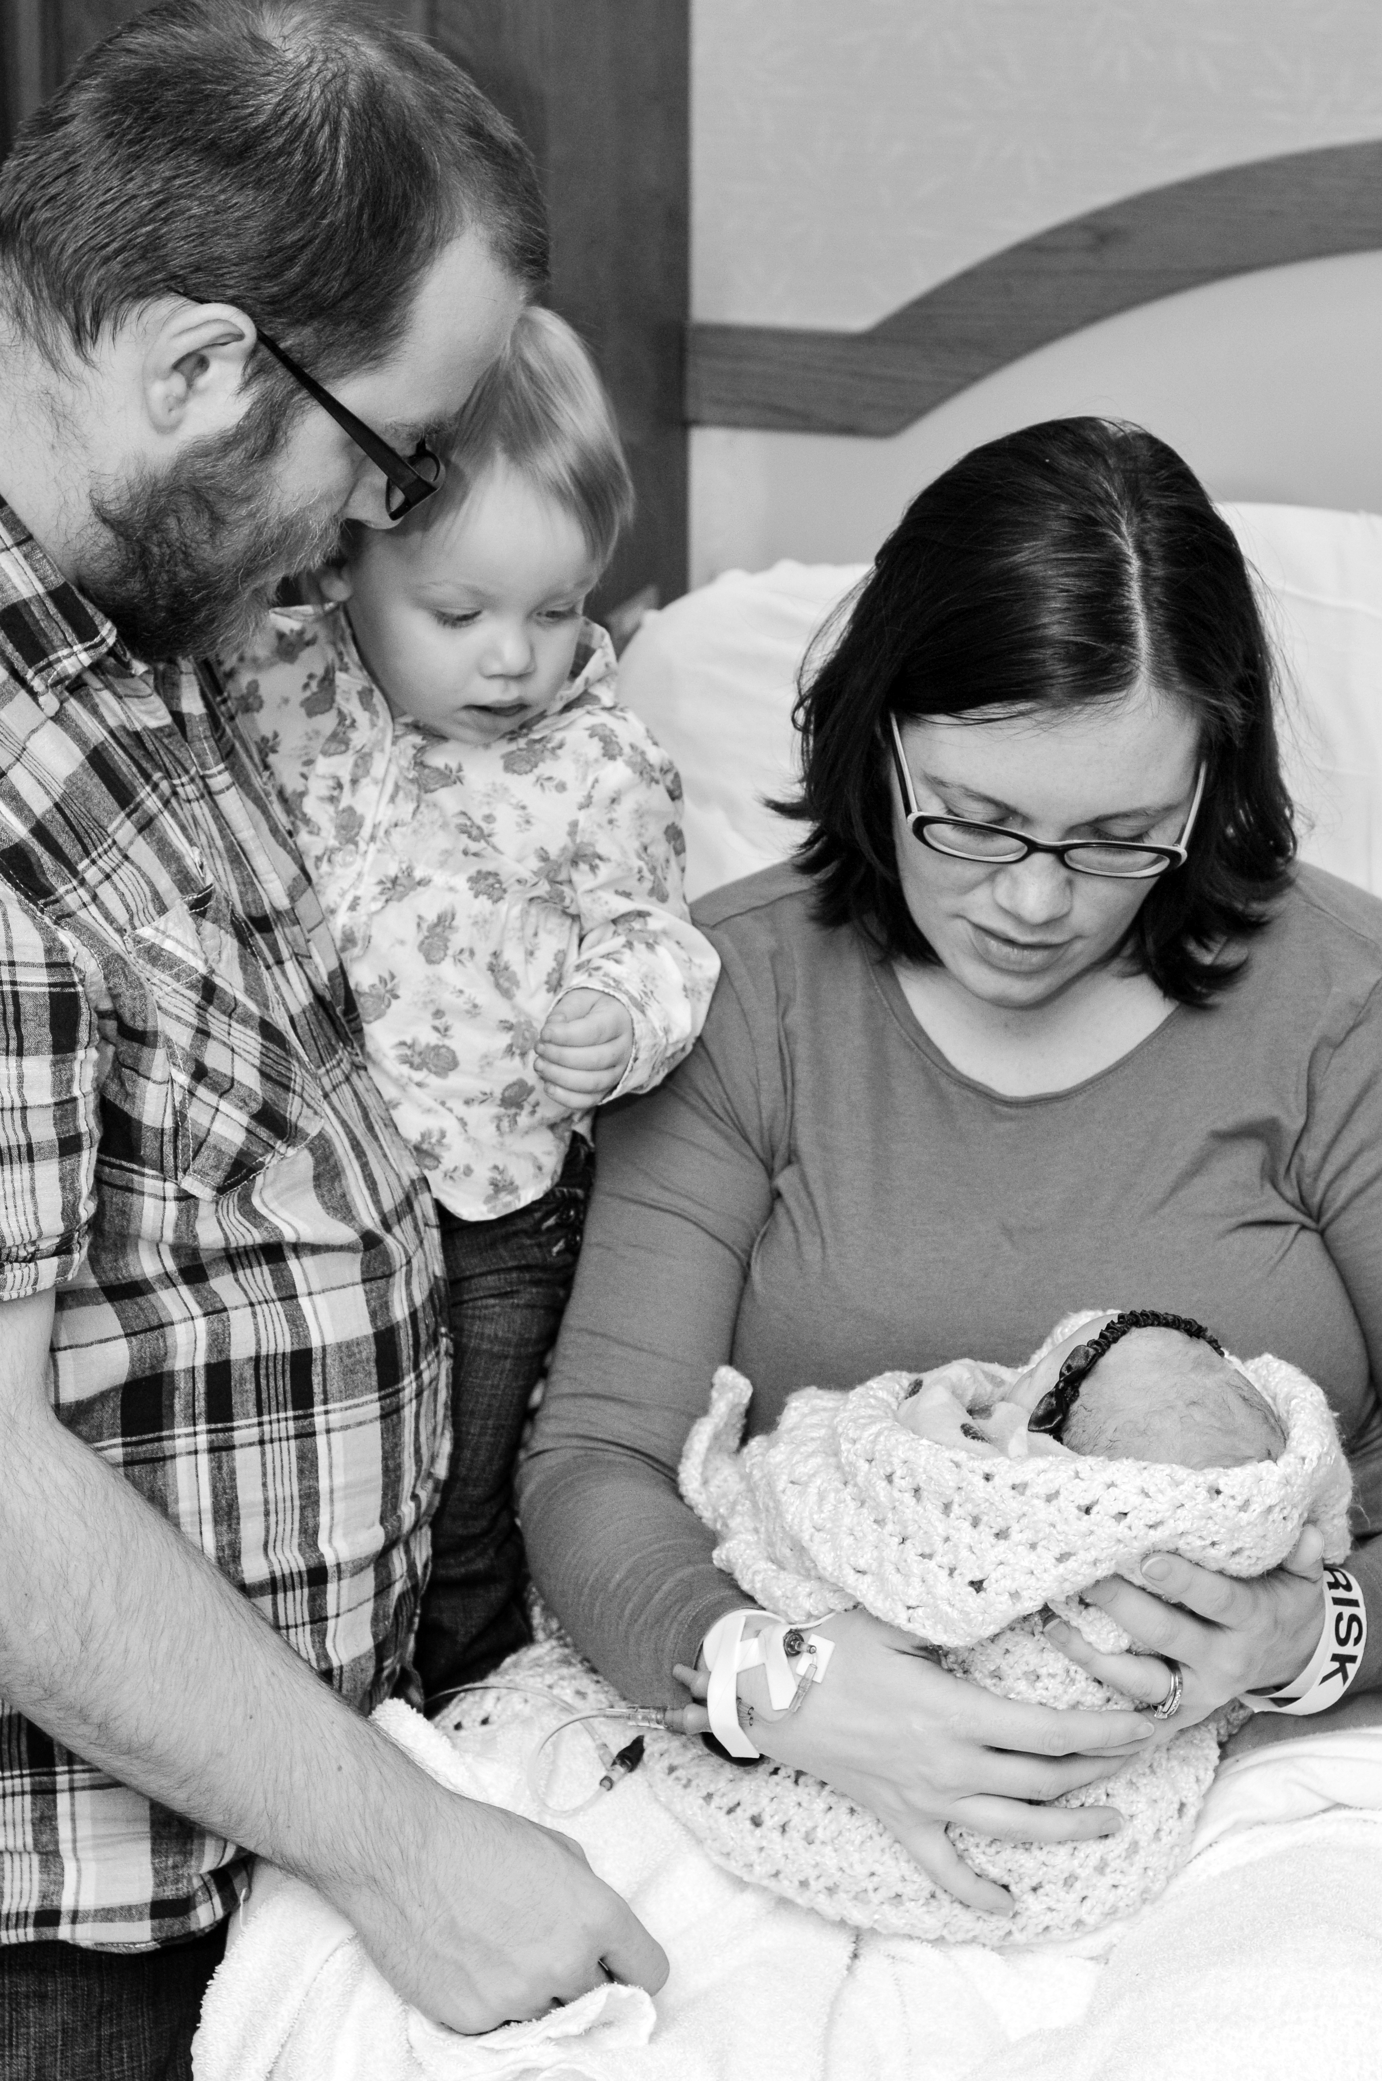
Why this support matters
Norah Lynn McKenzie
12/31/2011

Slide 4
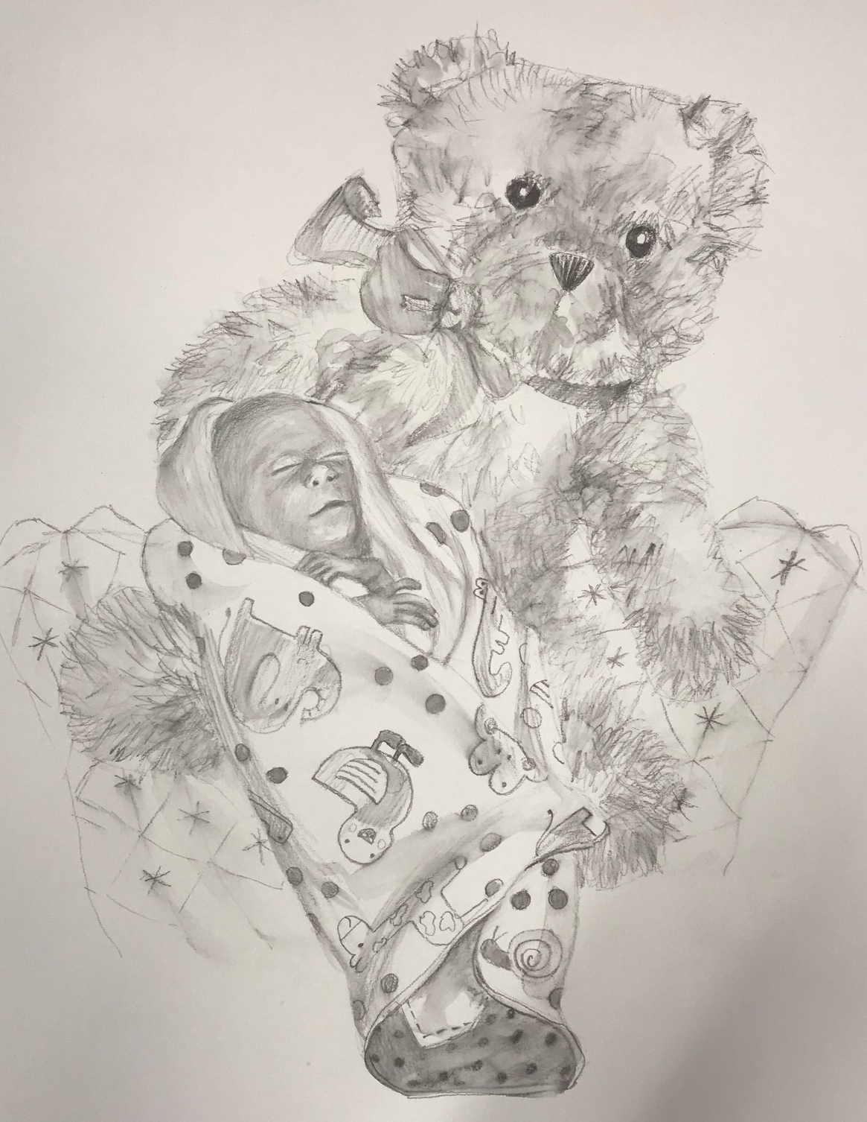
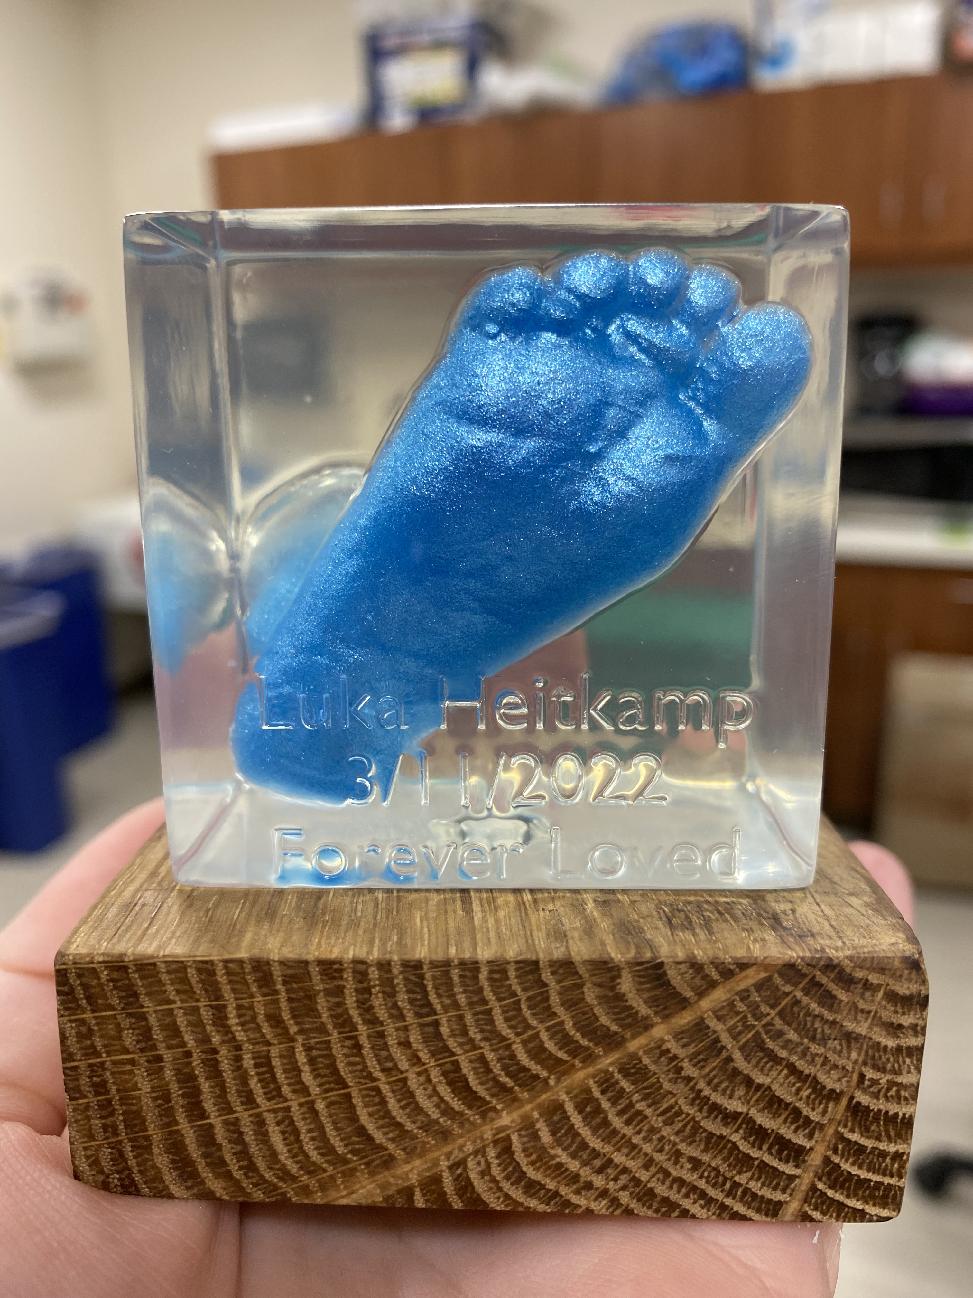
What we do
Remembrance photography
Inked hand and footprints
Clay impressions
Castings
Lock of hair
Clothing, hat, blanket, diaper
Teddy bear
Beaded bracelet/keychain
Healing Artists drawing
Forever in Your Heart 3D scan
Intentional memory-making opportunities

Slide 5
Local Resources
Support Groups
Other Supports
Parkview Healing Hearts and PALS
Dupont Connections and PPALS
Icing for Izaac and Redwood Inn
While We’re Waiting
Healthier Moms and Babies
Remembering Rowan
Now I Lay Me Down to Sleep
Young Mothers of America Remembrance Walk
Walk to Remember Fort Wayne

Slide 6
Thank you
Cori McKenzie MSW
Parkview Health
Cori.McKenzie@Parkview.com
260-210-0323

