Slide 1
Infant Mortality & FIMR
Britte Nihart, MSN, RN
Allen County FIMR Coordinator

Slide 2
What is FIMR?
FIMR stands for Fetal & Infant Mortality Review. It is a national community-based, action-oriented process of reviewing fetal and infant death cases in an effort to improve maternal and infant health outcomes (NCFRP, 2020).

Slide 3
Infant Mortality Rate
The infant mortality rate is defined as the number of infant (under one year of age) deaths per 1,000 live births
Fetal refers to 20 weeks gestation until birth

Slide 4
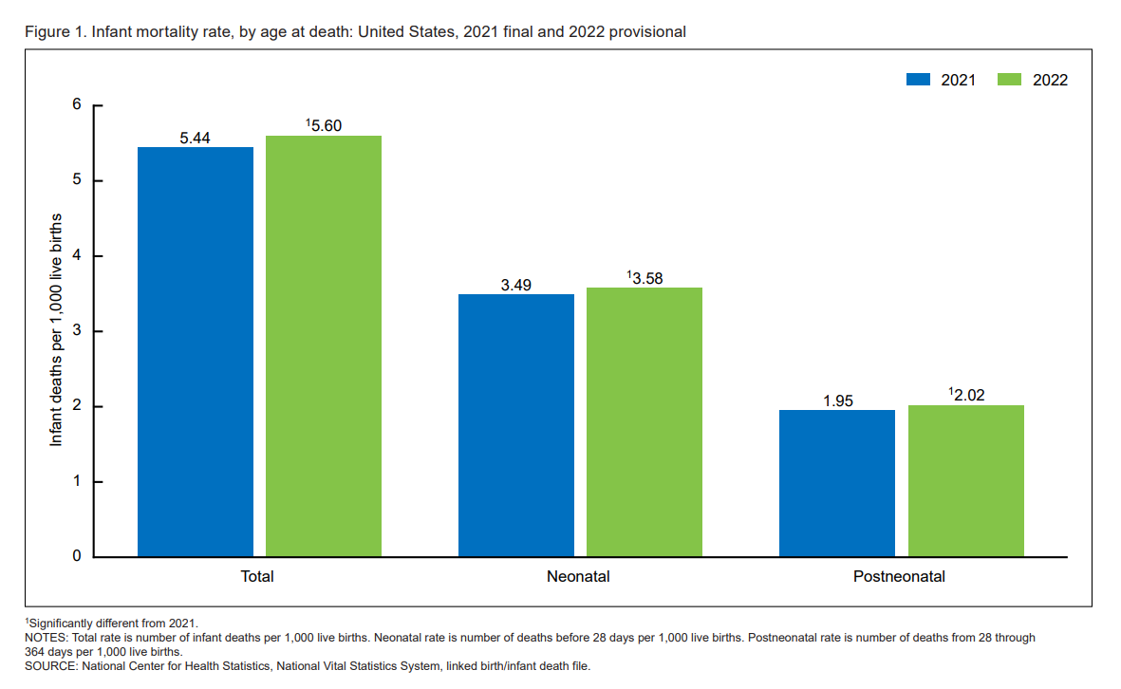

Slide 5
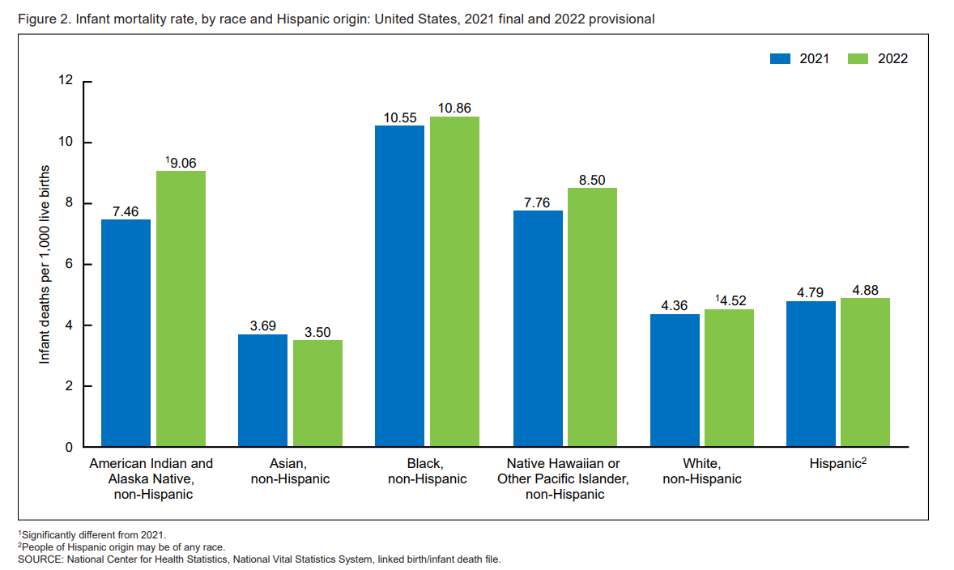

Slide 6
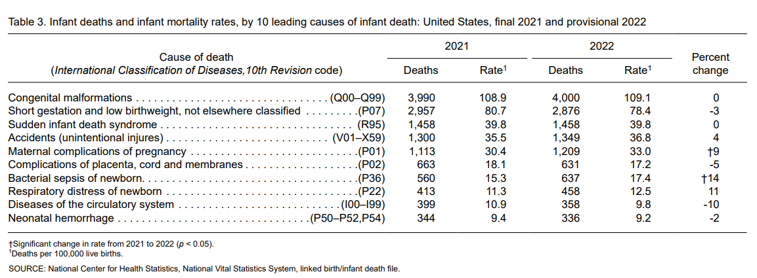

Slide 8
Allen County FIMR Data
2021
2022
44 infant deaths
40.9% Black/54.5% White
15.9% SUID/Unsafe sleep
55% Preterm
34 infant deaths
~*39.4% Black/45.5% White
21.9% SUID/Unsafe sleep
59.4% Preterm

Slide 9
Why Does It Matter?
A barometer of the overall health and wellbeing of a community
Indicator of the socioeconomic state of a community
Helps shine the light on disparities
For the families that experience the loss of a baby, it can shape the rest of their lives
These families need to be supported and we need to learn from their experiences

Slide 10
Thank you
Britte Nihart, MSN, RN
Britte.nihart2@parkview.com

