Slide 1
A Mother’s
PE
HOPE

Slide 3
Roughly 33% of the U.S. homeless population are families with children.
For every 100 low-income households in the U.S., only 28 units of affordable housing are available.
Research shows that homelessness and housing instability have a negative impact on the health of infants, children, adolescents, and pregnant and parenting women.
Pregnant women who are homeless are more likely to deliver preterm and low birthweight babies.
For children and adolescents, housing instability and multiple moves are associated with increased behavioral problems, poor school performance, higher incidence of teen pregnancy, and greater likelihood of developing a mental illness.
In addition, any child younger than 18 who experiences homelessness is at a heightened risk for early substance use, in addition to many other developmental risks.
the
ISSUE

Slide 4
Stable, safe housing before, during, and after pregnancy is critical to promoting positive maternal and infant health outcomes.
SAMHSA’s Behavioral Health Services for the Homeless guide notes that all issues facing homeless individuals with mental illness and SUD must be addressed concurrently for treatment to be effective.
Treatment needs to combine stable housing with therapy, support services, and employment, if possible.
Treatment options for behavioral health conditions generally include counseling, psychotherapies, medications, or a combination of these approaches tailored to individual needs.
Case management and coordination of individuals to medical, psychological, and social services is also critical to successful treatment.
possible
SOLUTIONS

Slide 5
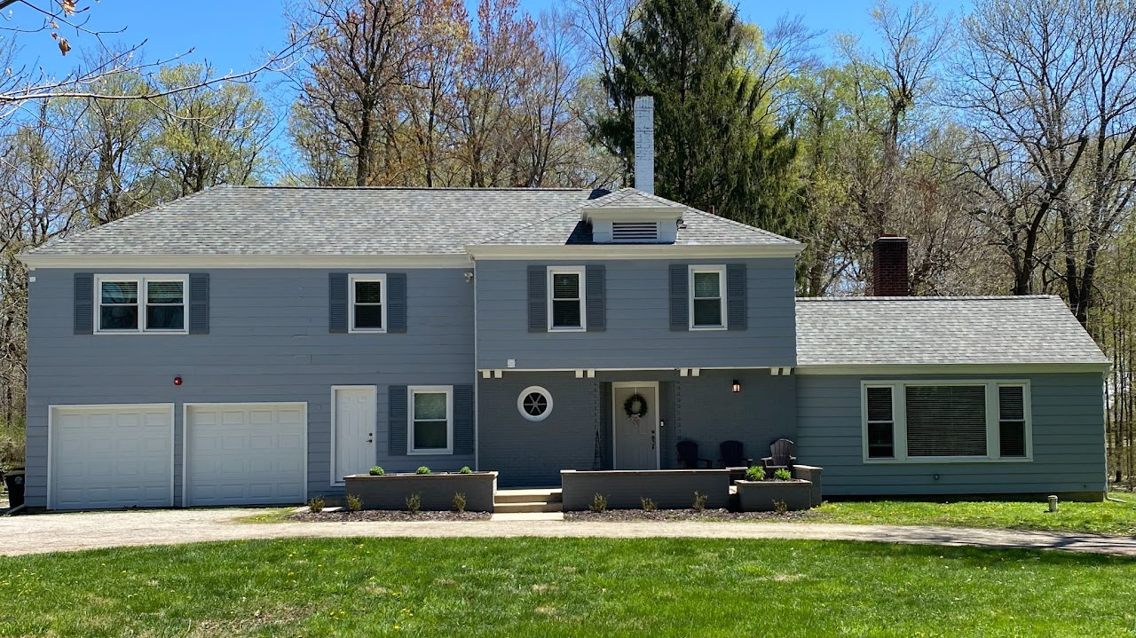
introducing
AMH
What we do: Provide housing, basic needs, and supportive services for pregnant women experiencing homelessness in Northeast Indiana.
History: Established in 2015; opened physical location in October 2018.
Capacity: Safe, supportive environment for up to 8 women and their babies.
Program: Goal-oriented, promoting family stability.
Support: Staffed 24/7 for resident support and guidance.
Focus: Strong spiritual emphasis and a holistic approach to physical, emotional, mental, and spiritual wellness.
AMH House
Est. 2018

Slide 6
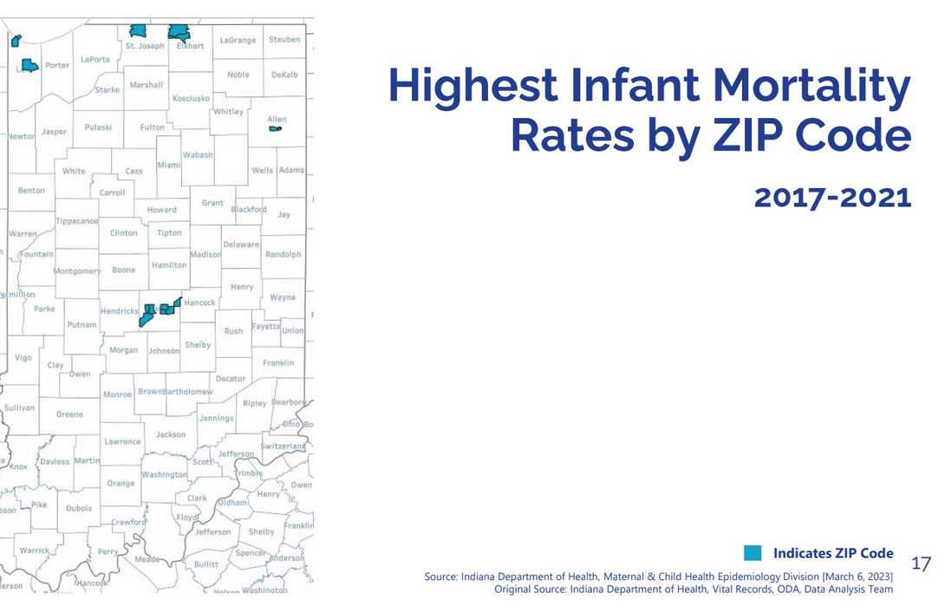
91
the
in our maternity home program since 2018
NEED
536
Homeless pregnant women have a unique set of needs and challenges that is best addressed through programs designed specifically to meet these needs.
When basic needs are not being met, pregnant women are unable to focus on obtaining prenatal care and addressing other health needs which can negatively affect birth outcomes.
Hoosier babies died before their 1st birthday in 2021
2,700+
infant lives lost in the last 5 years

Slide 7
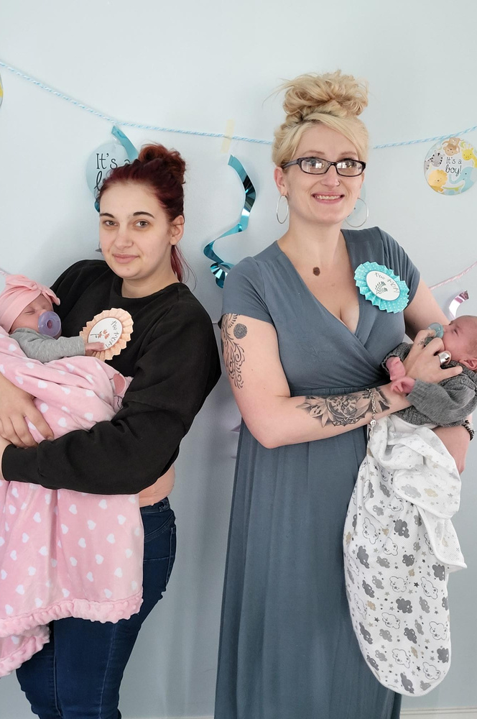
AMH
PROGRAM
Our program begins during pregnancy and extends through the birth of baby
If need presents, women can remain in our program up to one year after babies are born
Average length of stay is six months
Each woman is required to meet a personal productivity goal each week
Her productivity in the program includes:
Intensive weekly case management
On-site therapy
Health check in
AMH classes
Parenting education videos.
Daily, residents must attend our morning huddle with optional devotional and complete their chores.

Slide 8
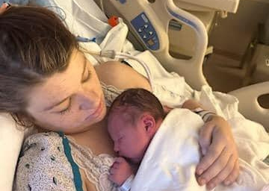
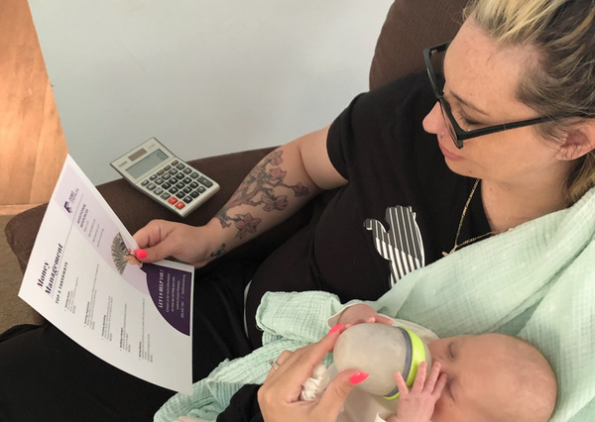
program
Shelter
Health of Mother & Baby
AREAS
We have found that focusing on these areas of the residents’ lives provides the most opportunities to gain confidence, knowledge, and hope; ultimately supporting them in becoming self-sufficient upon completion of the program.
Education
Employment
Support
Life Skills (HOPE Program)

Slide 9
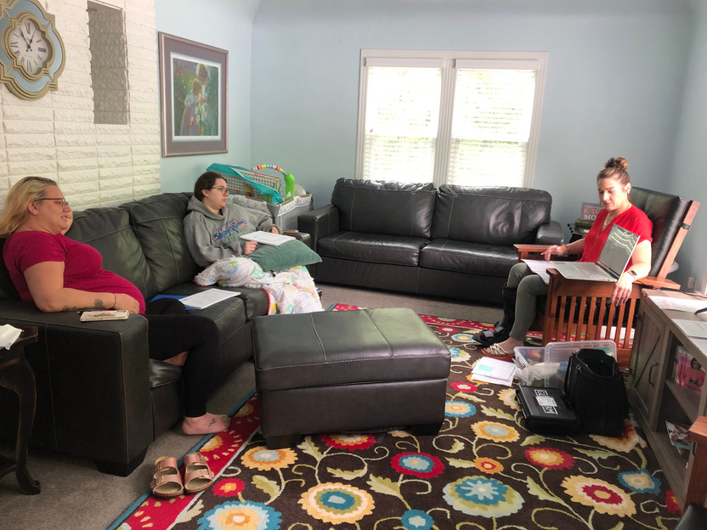
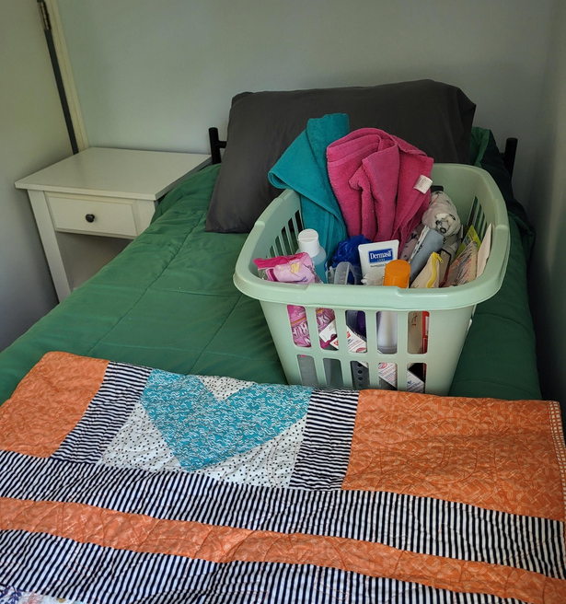
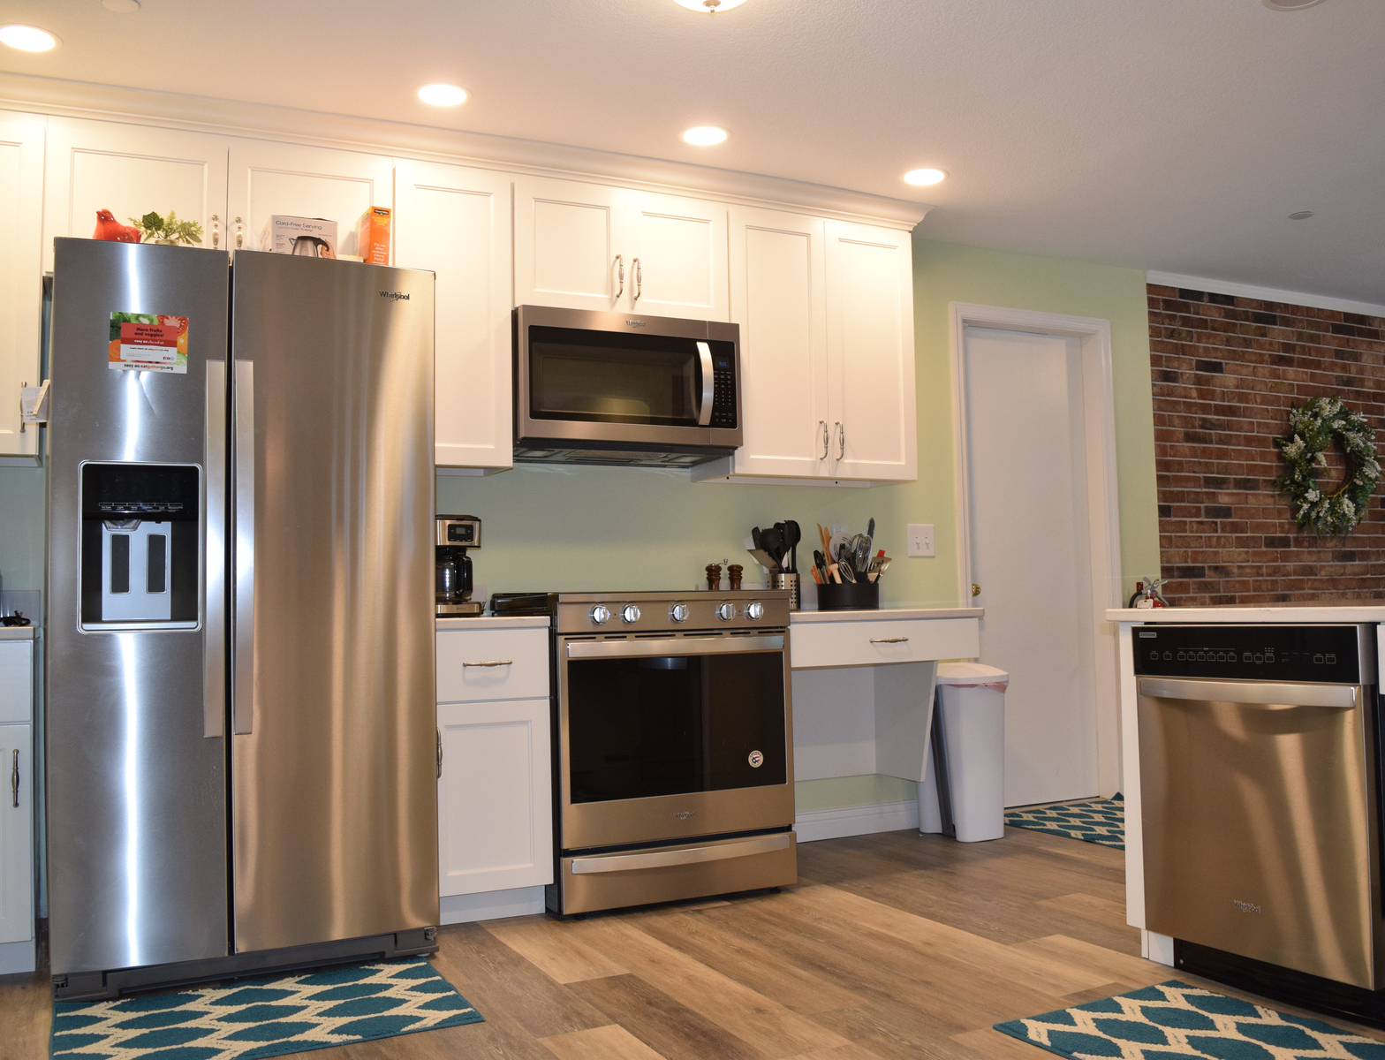
the
HOUSE
At A Mother's Hope, we prioritize the safety and integrity of our home to ensure residents feel secure. We take careful measures to minimize the number of people coming in and out of the home, creating a stable environment where residents can feel comfortable without the presence of unfamiliar faces intruding on their space.
Living Area
Bedroom
Kitchen

Slide 10
01
Pregnant
02
Homeless
Or at risk for homelessness
resident
03
Follow Rules
Willing to follow the rules and structure of the home
QUALIFICATIONS
04
Participation
Willing to participate in A Mother's Hope program
In order to be considered for A Mother's Hope program you must be:
05
NO Drugs & Alcohol
Committed to living drug and alcohol free
06
Federal Poverty Guideline
Have an income that is at or below 150% of the Federal Poverty Guideline

Slide 11
intake
PROCESS
Please note that AMH is not “an emergency shelter.”
To apply for A Mother’s Hope program:
Pregnant women can contact us by phone or through the website.
If women do not meet the criteria for our program, our staff will try to guide them towards other community resources.
If we have an opening, we will set up a time for them to come to A Mother’s Hope.
At that meeting, we will get to know the women better and let them know what they can expect in this program. This meeting is a great time for them to see the house and ask any questions they might have.
If accepted into the program, we will set up a day and time for them to move into A Mother’s Hope.
If they are not accepted, we will do our best to guide them on where might be a better fit for them.
The average time from the 1st intake meeting to moving-in is about 7 days.

Slide 12
STAFF
At A Mother's Hope, we are committed to providing unwavering support to our residents. Our facility is staffed 24 hours a day, 7 days a week, including holidays, ensuring that the safety and care of our residents are always our top priority.

Slide 13
33% of moms were first-time moms
83.33% of residents that stayed in the program longer than 6 months were stably housed at exit
100% of babies born at A Mother’s Hope were born at a healthy birth weight (over 5 lbs. 8 oz.).
Residents spent 2,318.75 hours working on education including AMH classes, Brightcourse, and other individual educational opportunities
2023
OUTCOMES
100% of women had health insurance at exit
100% of residents received counseling (230 mental health appointments completed)
100% of babies born at A Mother’s Hope were full-term (greater than 37 weeks gestation).
67% of women in recovery had been sober for 90 days or more at exit
68.4% of women had increased their income at exit

Slide 14
(260) 444-4975
thank
www.AMothersHopeFW.org
YOU

