Slide 2
Housing Continuum & Services
No Shelter
Housing and Urban Development (HUD) definition of homelessness
What is Homeless Category 1: Literally Homeless? (§ 578.3)*
Individual or family who lacks a fixed, regular, and adequate nighttime residence, meaning:
Has a primary nighttime residence that is a public or private place not meant for human habitation; or
Is living in a publicly or privately operated shelter designated to provide temporary living arrangements (including congregate shelters, transitional housing, and hotels and motels paid for by charitable organizations or by federal, state and local government programs); or
Is exiting an institution where (s)he has resided for 90 days or less and who resided in an emergency shelter or place not meant for human habitation immediately before entering that institution.
*3 other categories for imminent risk, other federal statutes, and fleeing DV; source: hudexchange.info

Slide 3
Housing Continuum & Services
The McKinney-Vento Definition of Homeless – Eligibility for additional Educational Services
The term “homeless children and youths”–
(A) means individuals who lack a fixed, regular, and adequate nighttime
(B) includes–
(i) children and youths who are sharing the housing of other persons due to loss of housing, economic hardship, or a similar reason; are living in motels, hotels, trailer parks, or camping grounds due to the lack of alternative adequate accommodations; are living in emergency or transitional shelters; or are abandoned in hospitals;*
(ii) children and youths who have a primary nighttime residence that is a public or private place not designed for or ordinarily used as a regular sleeping accommodation for human
(iii) children and youths who are living in cars, parks, public spaces, abandoned buildings, substandard housing, bus or train stations, or similar settings; and
(iv) migratory children

Slide 4
Housing Continuum & Services
Temporary Housing: Time limited housing options
Emergency Shelter
Emergency Shelter is a facility that offers overnight sleeping accommodations, typically with a time limit of 45 days or less.
Just Neighbors, The Rescue Mission/ Charis House, St Joseph Missions, YWCA
Transitional Housing
Transitional housing provides temporary housing accommodations and supportive services to people without permanent housing options over a longer timeframe than emergency shelter; may charge fees.
A Mother’s Hope, Shepherd’s House, Vincent Village, YWCA Hope and Harriet

Slide 5
Housing Continuum & Services
Other Resources
Coordinated Entry (CE)
A prioritization list to ensure that the individuals most in need are connected to housing resources; CE assessment is completed, scored, and determines what services/ housing they are eligible for. Focus on HUD homeless definitions.
Brightpoint is lead agency; others can complete the assessment
Street Outreach
Trained service providers who meet individuals where they live or at other public sites to offer services. Connect to needed resources such as housing, food, medical care and transportation.
HART, PATH, Project.ME, PRC, TRM

Slide 6
Housing Continuum & Services
Permanent Housing: Tenant signs lease for their own unit
Rapid Rehousing Housing (RRH)
The Rapid Rehousing program provides subsidized permanent housing with supportive services for up to 24 months
Permanent Supportive Housing (PSH)
Provides homes and services for people in need of long-term support. Vouchers available for those who qualify as chronically homeless: HUD definition for housing status as well as a qualifying disability.
Affordable Housing Rentals
When ready to obtain own housing, tenants should look to spend no more than 30% of their income on rent each month

Slide 7
Housing Continuum & Services
Vouchers
Housing Choice Vouchers (HCV), formerly known as Section 8, are offered through Fort Wayne Housing Authority (FWHA) via waiting list; priority is given to those experiencing homelessness
Rental Assistance Programs
Other vouchers and rental assistance programs, such as RRH and PSH, may be available from time to time
Veterans Services
Based on veteran status, additional housing resources may be available.
Brightpoint (SSVF), VA (others)

Slide 8
Local Housing Statistics
$20.94/hr or $43,560/yr Full Time Wage needed to afford Market Rate 2-Bedroom rental at $1089/mo
Since 2020, income needed for median rent is higher than average income of renter households
61.4% Single parent households are rent burdened, spending over 30% income on rent versus 39.7% for all households
45% increase in Allen County rent averages from 2017-2022
Less than 8% of available rentals are affordable for households at risk of homelessness; over 90% of these households are rent burdened
Sources: indianahousingdashboard.com, Prosperity Indiana, June 2024, local landlord conversations

Slide 9
Renter Tips
Know your lease: late payments, notice requirements; failure to pay rent for even one month may lead to eviction filing
Landlords want 3x the rent amount in monthly income
Landlords screen for rental history, criminal history, and credit score; no credit is better than bad credit; eviction history makes it harder to obtain a new lease
Be familiar with Renter’s Rights

Slide 10
Eviction Information- Allen County
Eviction is about possession of the property;
Damages is about money owed.
Tenants can work out arrangements with landlord prior to Initial Hearing; Tenants should show up to all hearings; Hearing will determine time Tenant has to vacate property if Landlord is entitled to legal possession of the property; Damages are determined at a separate hearing; Some evictions can be sealed if certain criteria are met;
NO ONE with a valid lease should be forced to leave a property without the landlord going through the eviction process.

Slide 11
Housing Stability Resources
Just Neighbors
eip@ihnfw.org or 260-918-6662
Legal Help
Indiana Legal Services, Inc.:
Call M-F 10AM - 2PM 844-243-8570 or www.indianalegalservices.org
Volunteer Lawyer Program:
Call 260-407-0917.
Talk to a lawyer for legal advice
Legal Line: 260-423-2358, Tuesdays 5 p.m. - 7 p.m.
Eviction Clinics: 347 W. Berry St Suite 101, Fort Wayne, IN 46802
      1st Wednesday, 6-8 p.m.
      3rd Wednesday, 1-3 p.m.

Slide 12
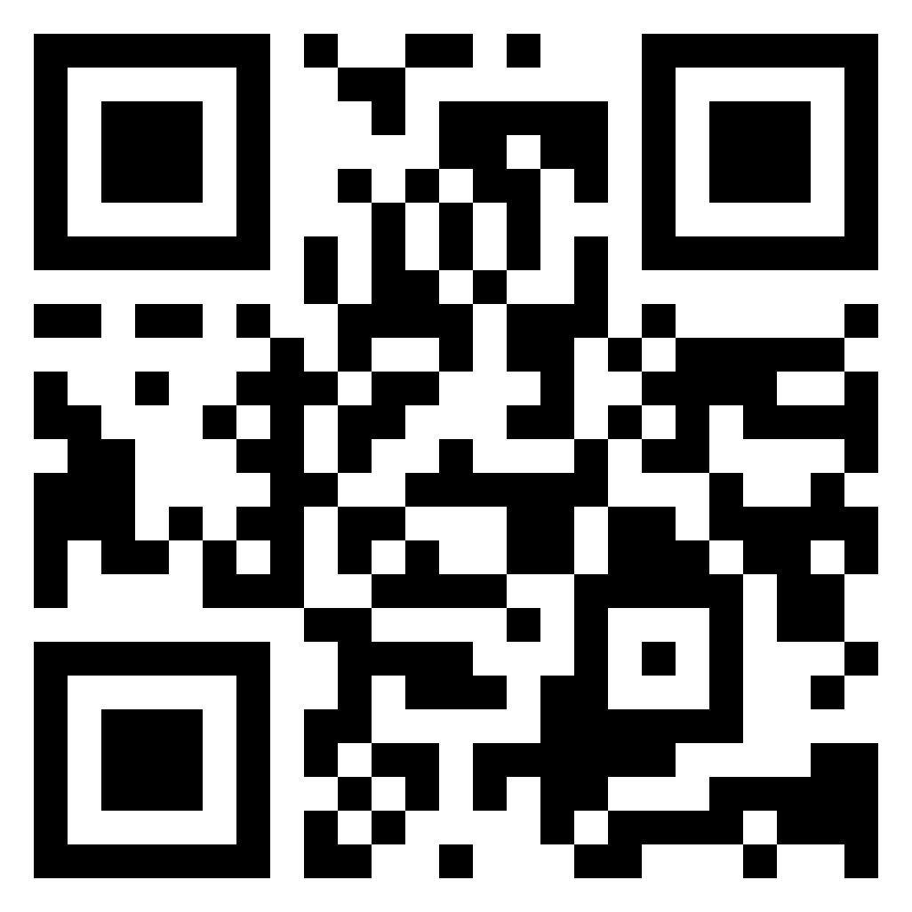
Scan to visit Everyone Home’s website

