Slide 1
Infant Mortality &
FIMR Updates

Slide 2


Slide 3
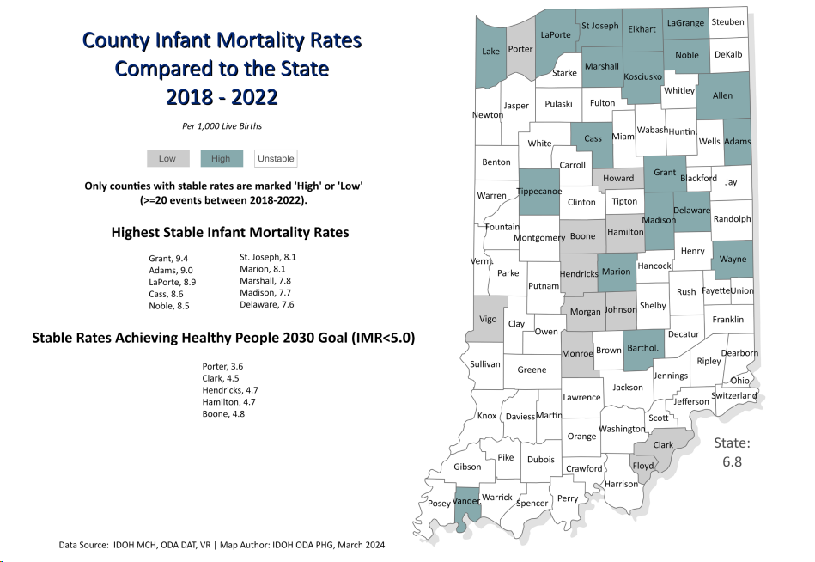

Slide 4
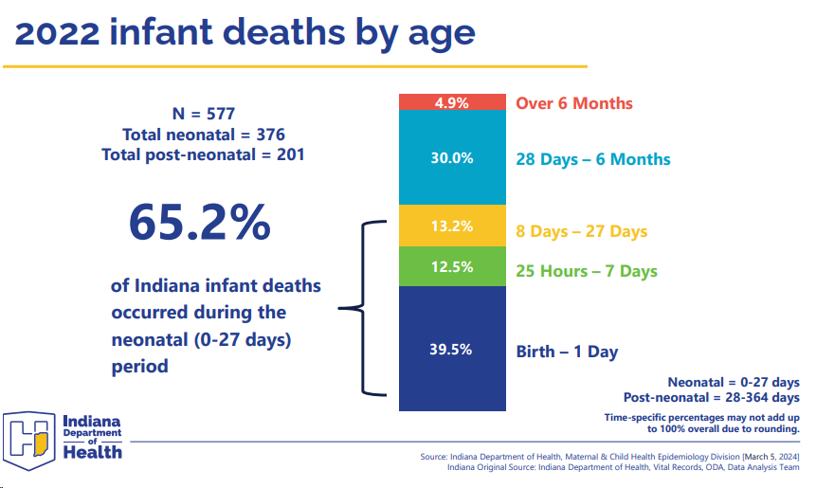

Slide 5
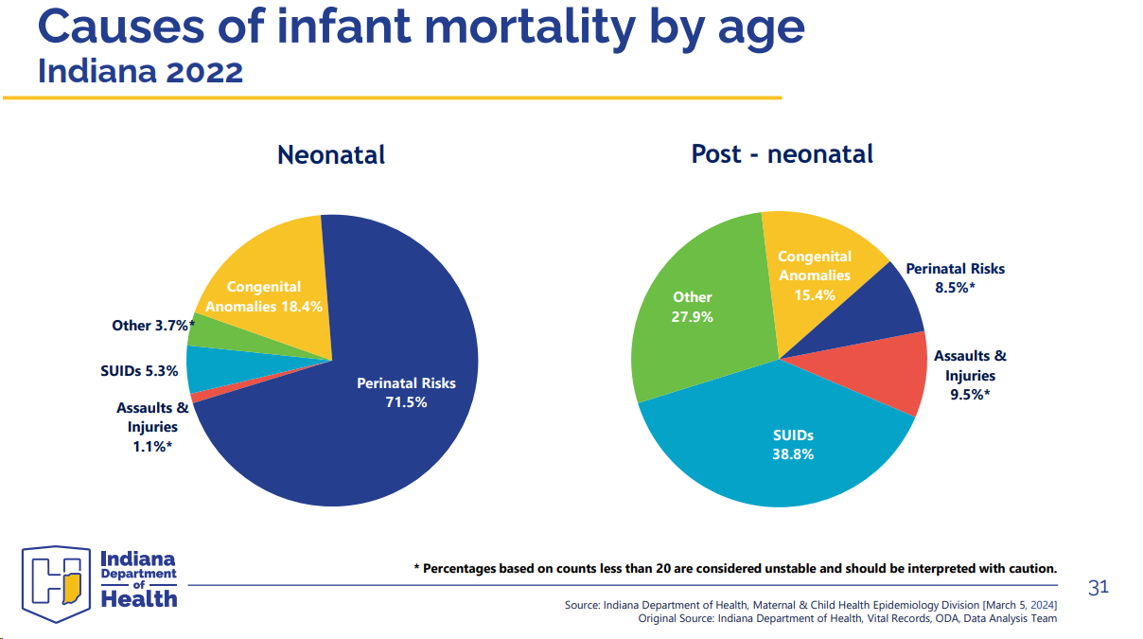

Slide 6
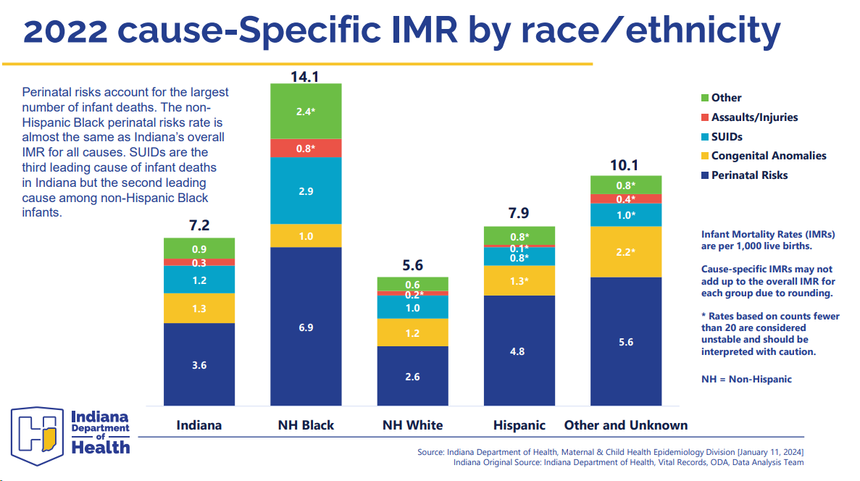

Slide 7
2022 Indiana FIMR Case Review Data – Fetal and Infant Fatalities

Slide 8
2022 Indiana FIMR: fetal and infant birth weight (N=184)
Source: Indiana Department of Health 2022 Local FIMR Team Reporting Database

Slide 9
2022 Indiana FIMR: fetal and infant gestational age (N=184)
Source: Indiana Department of Health 2022 Local FIMR Team Reporting Database

Slide 10
2022 Indiana FIMR: maternal BMI (N=184)
Source: Indiana Department of Health 2022 Local FIMR Team Reporting Database

Slide 11
2022 Indiana FIMR Case Review Data – Social Determinates of Health

Slide 12
2022 Indiana FIMR: maternal education level for fetal and infant cases reviewed (N=184)
Source: Indiana Department of Health 2022 Local FIMR Team Reporting Database

Slide 13
2022 Indiana FIMR: maternal insurance coverage (N=184)
Source: Indiana Department of Health 2022 Local FIMR Team Reporting Database

Slide 14
2022 Indiana FIMR: maternal traumatic or stressful life events present (N=184)
Traumatic or stressful life events can include experiences such as: death of a loved one, being the caregiver of a chronically ill child or family member, incarceration, divorce, loss of housing, unemployment, etc.
Source: Indiana Department of Health 2022 Local FIMR Team Reporting Database

Slide 15
2022 Indiana FIMR: food desert impact (N=184)
Limited access to affordable and healthy foods
Source: Indiana Department of Health 2022 Local FIMR Team Reporting Database

Slide 16
2022 Indiana FIMR: screened for food insecurity during pregnancy (N=184)
Source: Indiana Department of Health 2022 Local FIMR Team Reporting Database

Slide 17
2022 Indiana FIMR: screened for housing security during pregnancy (N=184)
Source: Indiana Department of Health 2022 Local FIMR Team Reporting Database

Slide 18

Allen County
FIMR review findings

Slide 19
Causes of Infant Death – Allen County N=36
19

Slide 20
2023 Allen Co
Deaths by ZIP code
Notes:
A quarter of the deaths in the county are in two ZIP codes

Slide 21
Evolving Case Reviews
Collecting more data on SDOH and co-morbidities
Maternal Health impacts fetal and infant health
Mental Health concerns also common in more than half of cases
Condition | Measurement
Maternal comorbidity | 31%
Smoking/ nicotine use | 28%
Recreational drug use | 25%
Overweight/Obese | 89%

Slide 22
Analysis/ Trends
Black IMR continues to be disproportionately higher than other races
About half of these deaths are “preventable”
Maternal Mental Health is already an issue for these families prior to the infant/pregnancy loss
Most families were supported by Bereavement Coordinators
Across the state, 6% of births exposed to smoking during pregnancy, however 28% of FIMR cases in AC were exposed to nicotine
Across the state, 36% of adults are considered obese, 89% of our cases included this contributing factor.

Slide 23
Recommendations
Fetal Kick Counts could have made a difference in several cases where calls to providers were delayed because pregnant women did not know it was an important symptom to watch and report.
Screening for SDOH needs to be standard for prenatal care everywhere
Being healthy before pregnancy would prevent some fetal and infant mortality or decrease perinatal risks
Maternal weight/BMI is a risk factor – do we talk about it?

